Slide 1
July 2022 Webinar Outbreak READY! Scope, Story, and Sustainability: Developing an Online Simulation for Strengthening Infectious Disease Readiness

Slide 2
GDHF 2022
https://gdhf2022.dryfta.com/

Slide 3
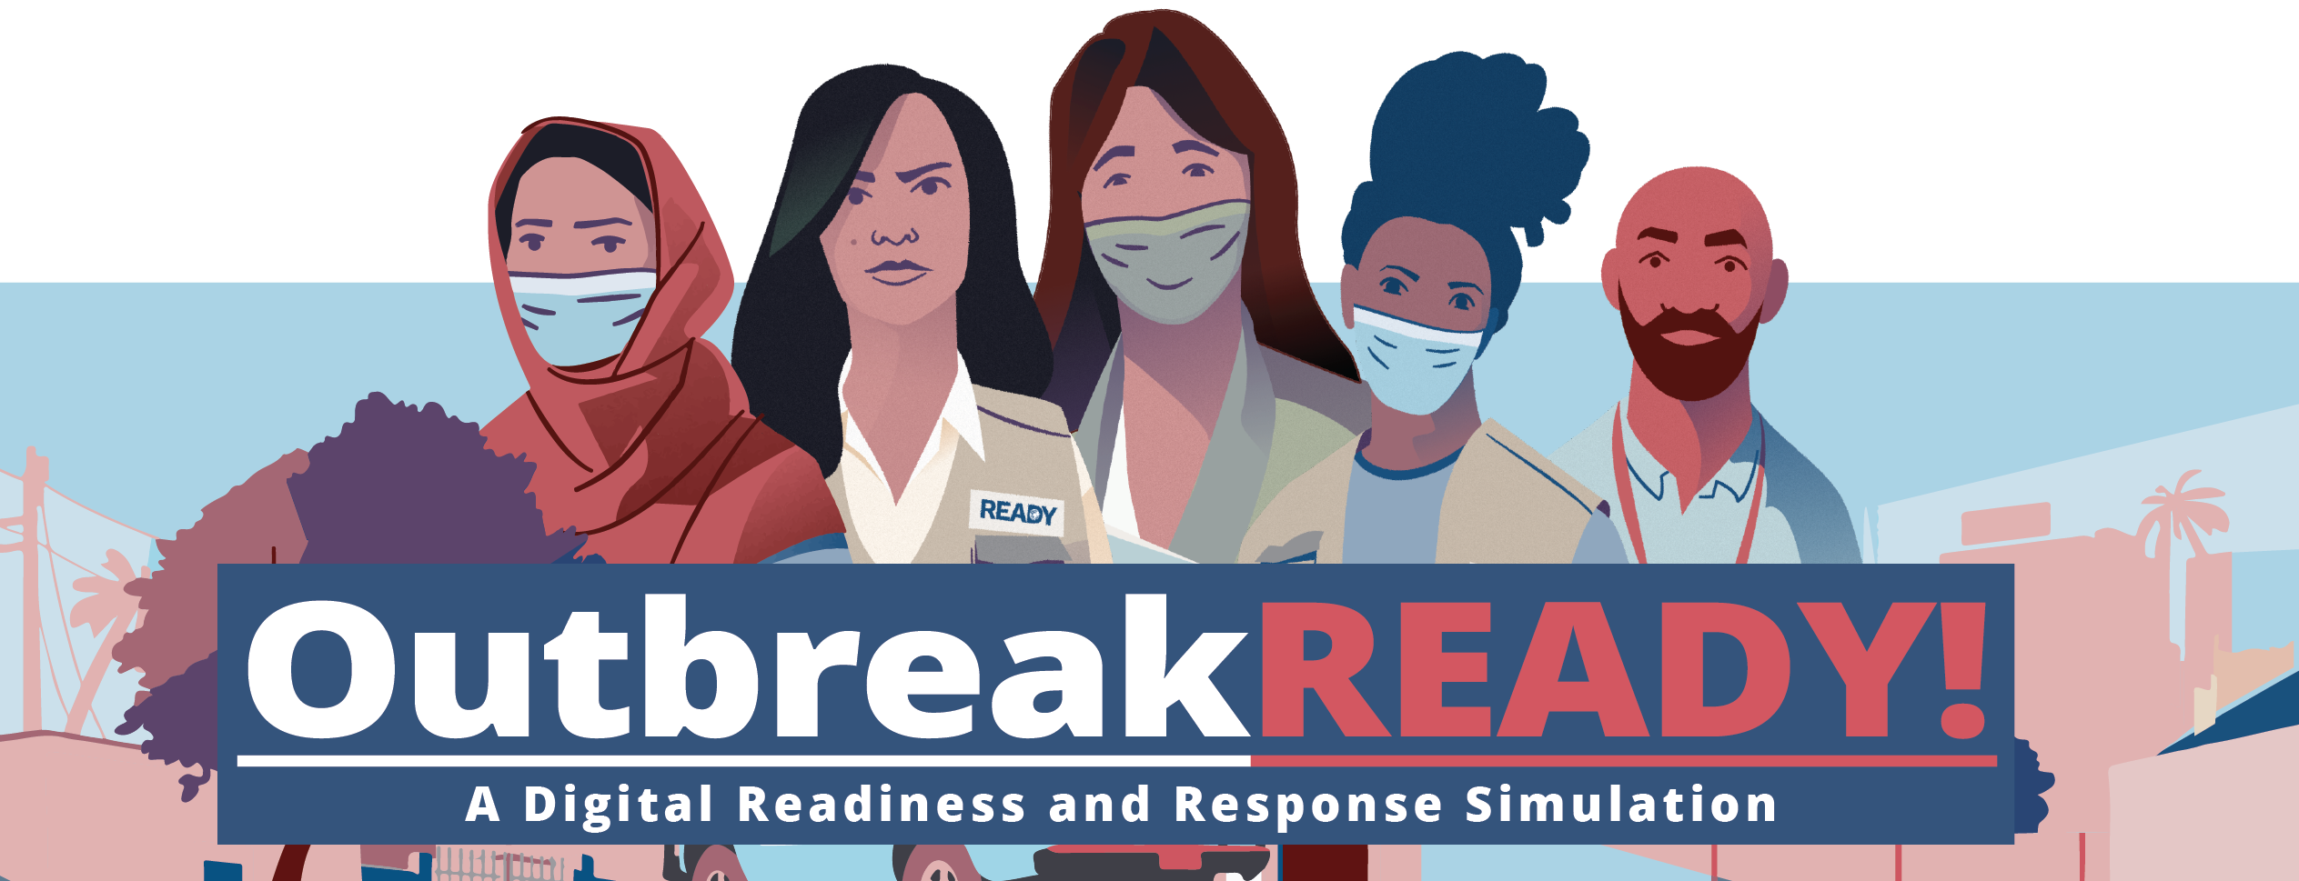

Slide 4
What is Outbreak READY!?
A capacity building simulation for humanitarian leaders using gaming technology as a tool
Estimated 2.5 hours of play
Team Leader in humanitarian NGO
Allows learners to be exposed to the pace, stressors, stakeholders, and key decisions and trade-offs
Tool for professional and organizational development
READY: Global Readiness for Major Disease Outbreak Response

Slide 5
Briefing Video
READY: Global Readiness for Major Disease Outbreak Response

Slide 6
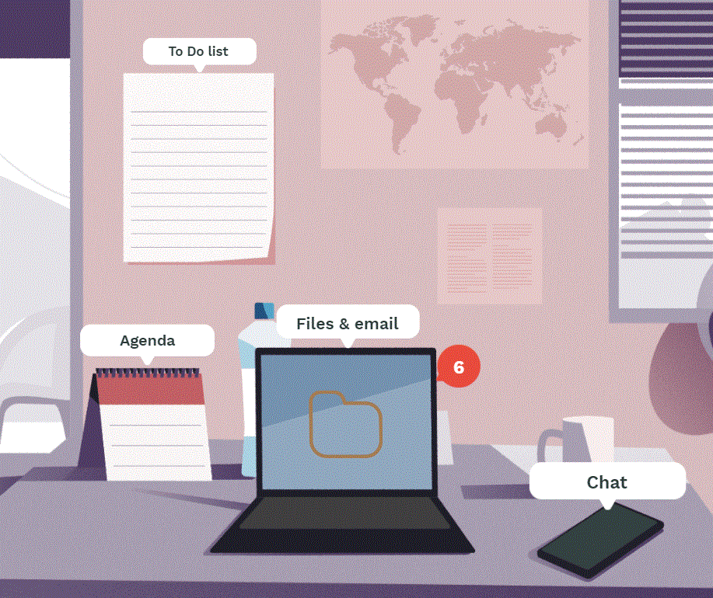
Why Outbreak READY!?
Originally intended to be an in-person simulation
Adaptive strategy to accommodate COVID-19 public health measures
Opportunity to utilize an innovative pedagogical tool
Available for free online via the READY website; allows training to reach a broader global audience
READY: Global Readiness for Major Disease Outbreak Response

Slide 7
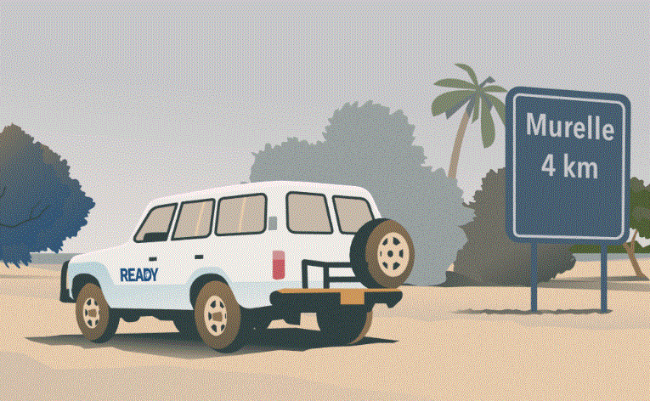
Who will benefit from Outbreak READY!?
National and international NGOs responding to humanitarian emergencies
NGO leaders and managers from both operational and technical backgrounds from across all sectors
Humanitarian adjacent actors, students, national ministries…etc.
READY: Global Readiness for Major Disease Outbreak Response

Slide 8
Outbreak READY! Development Timeline
Develop learning objectives & target audience
Build consensus with READY SMEs
April – May 2021
June - July
Build basic game construct
Develop narrative draft
August
Script content for module 1
User testing 1 with internal and external stakeholders
Draft narrative summary
September
Integrate module 1 content into game construct
Script content for module 2
User testing 2
October
Integrate module 2 content into game construct
User testing 3: Final
November
Final content and game construct updates
December
Online deployment of simulation
Available for open access
Jan – Mar 2022
Pilot Events & Launch
Facilitated simulation events in Cameroon, Sudan, & Turkey
Finalize accompanying tools
Outbreak READY! launch
READY: Global Readiness for Major Disease Outbreak Response

Slide 9
How was Outbreak READY! developed?
Digital Product
Led by &RANJ
Discovery/Design
Narrative Content
Led by READY
Alpha prototype
Beta prototype
Final version
Design Brief
Module 1
Module 2
Final revisions
READY: Global Readiness for Major Disease Outbreak Response

Slide 10
Digital Product Development Timeline
Notes:
Slide demonstrates the iterative process of developing a simulation: narrative content > game construct > user testing.

Slide 11
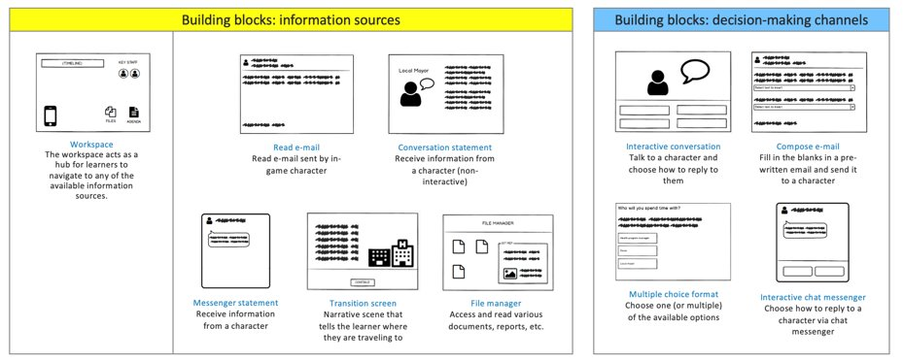
Digital Product Development
Notes:
In “Sprint 0” (the initial scoping/creative phase with the developer​) started the process with the question of how does a humanitarian Team Lead (our target audience and learner perspective) in real life gather information and make decisions during a response. Who are the stakeholders that they’re engaging with?​ Where are they primarily located on a typical day?
By this determined “building blocks” for the simulation – how the player is receiving info and how they are making decisions. ​
Gets information: emails, conversations with colleagues in the office, text messages, transition screens (when moving from place to place to provide insight into the setting), files (reports on computer) ​
How the player makes decisions: interactive conversation (1:1 and group settings – coordination meetings), compose email, multiple choice format, interactive chat messenger​

Slide 12
Digital Product Development

Slide 13
Narrative Development
Design Brief
Learning objectives
Narrative Overview
Summary of events by turn:
Micro/macro decisions
“Ghosted” Content
Summary of narrative mapped to building blocks
Target audience
Setting
Learner perspective
Conflict
Outbreak
Government
NGO
Options
Consequences
“Golden pathway”
Create first prototype
Content Drafting
Module 1
Module 2
Final review and revision

Slide 14
Narrative Development
Health, nutrition, WASH, Food Security & Livelihoods, Risk Communication & Community Engagement, Protection, epidemiology
Core Team
Primary Authors drafting content
Subject Matter Experts
Consultation
Project Leadership
Final review & revision
Pilot event participants
Review & Revision
User Testers
Feedback on versions of games
Sign-off
Notes:
Consulted with over a hundred interagency subject matter experts in the development of Outbreak READY. ​

Slide 15
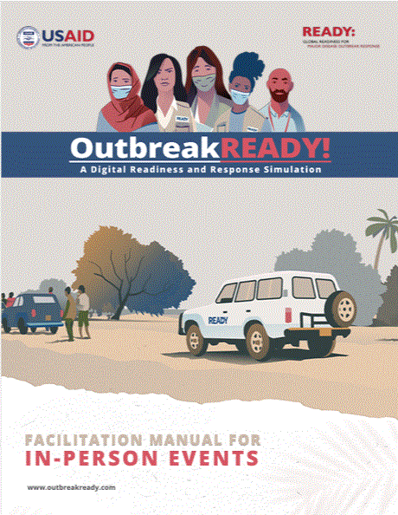
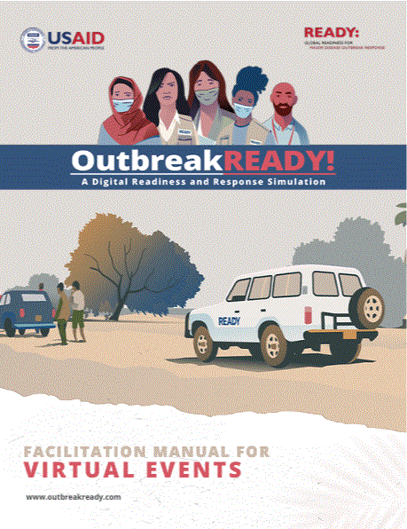
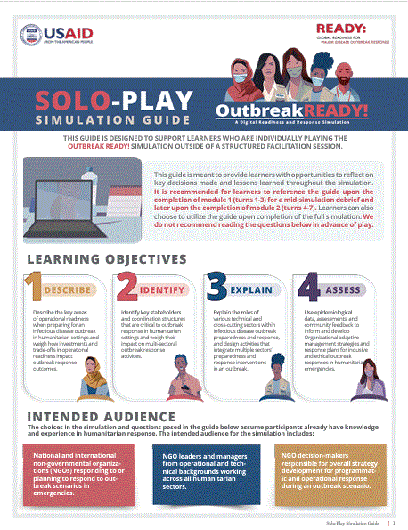
Accompanying Facilitation Tools
In-person Events
Virtual Events
Solo-Play Guide
Available in French, Spanish, and English
READY: Global Readiness for Major Disease Outbreak Response

Slide 16
Outbreak READY! Demo

Slide 17
Questions?
To learn more about READY and to play Outbreak READY!, please visit: www.ready-initiative.org.
READY: Global Readiness for Major Disease Outbreak Response

Slide 18
Join the GDHN!
https://bit.ly/GDHNSignUp

