Slide 1
Kenya COVID-19 Electronic Tracking Solutions
Dr Jacob Odhiambo
Global Digital Health Network Monthly Meeting, June 29th,2020

Slide 2
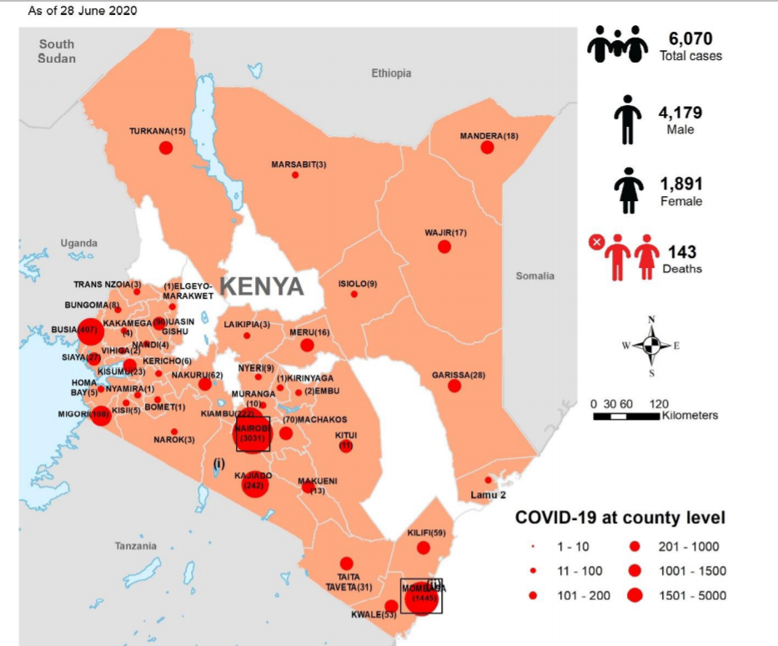
Overview
COVID-19 oriented solutions
Achievements
Data triangulation work
Ongoing activities and lessons learned
Notes:
Identify examples of meaningful data use
Describe the five stages of the data use cycle
Identify components integral to a data use brief
Think broadly about stakeholders
Identify questions of interest
Prepare meaningful analyses
Understand useful data review and discussion questions through examples

Slide 3




COVID-19 Surveillance Systems as of May 2020
1
Case
Identification & Notification
COVID-19 alerts can be received from the community or Points of Entry from:
Traveler surveillance at Points of Entry
Community sourced
If case has signs & symptoms
2a
Case Investigation & Laboratory Testing
COVID-19 investigation. A Rapid Response team investigates alerts by filling a case investigation form using:
COVID-19 app
KenyaEMR
Electronic lab order processing & results transmission using:
LMIS
System interoperability
If case turns positive
2b
Isolation of Confirmed Cases & Contact Management
Contact listing & follow up. Contacts are listed traced and followed-up using:
COVID-19 app
KenyaEMR
Contacts can self-register & self-report using:
Jitenge app
3
Quarantine Management
Institutional quarantine admission, follow-up, transfer & discharged from quarantine using:
KenyaEMR
Follow-up during quarantine. Institutional and home self-quarantine, self-registration, self-monitoring and self-reporting using:
Jitenge app
4
Strategic Information
LMIS
KenyaEMR
Jitenge app
ARC GIS
All the systems used can generate operational reports.
Lab reports
Surveillance reports
Follow-up reports
Integrated public visualizations

Slide 4
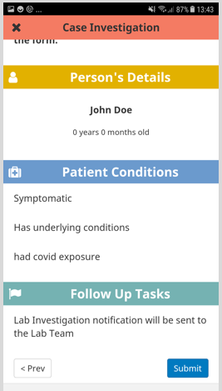
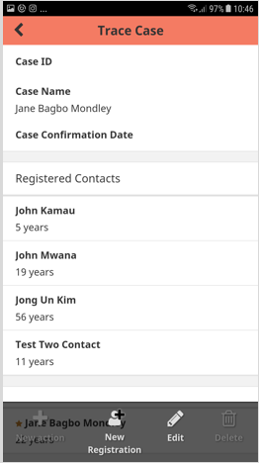
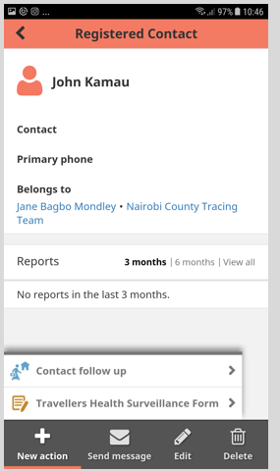
COVID Tracking App
Offline case investigation & contact tracing
Case Investigation
Contact Tracing
Contact Follow-up

Slide 5
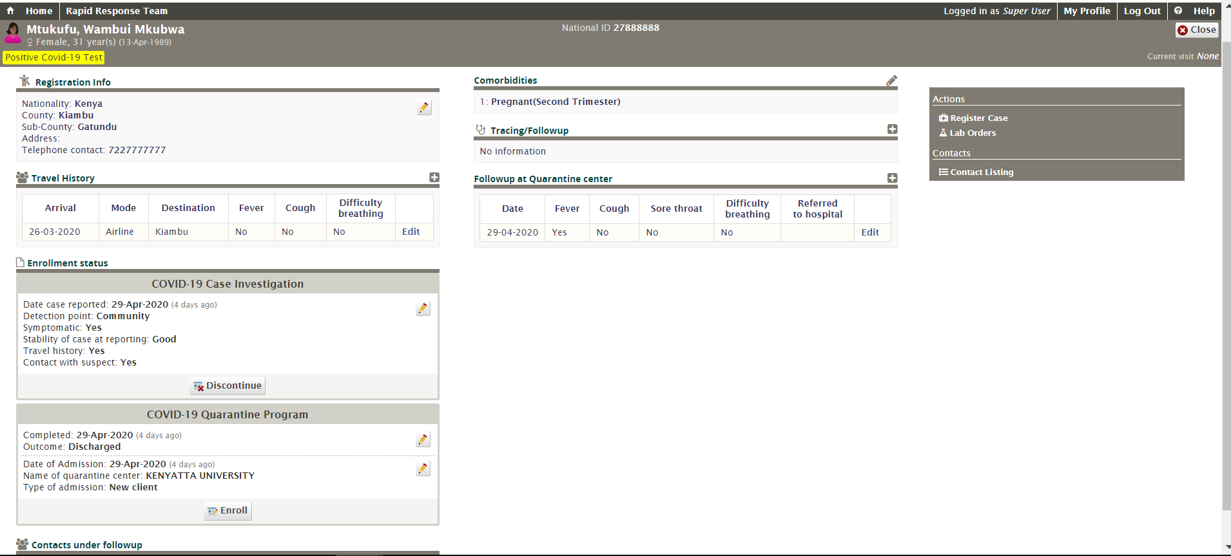
KenyaEMR: Case-based Surveillance System
Registration & travel history
Lab order management
Contact listing & follow-up
Case investigation
Quarantine management
Notes:
The contact tracing and the contact tree should be demonstrated herein, this information is lacking for most of the cases captured yet its important and a great value addition from using KenyaEMR.

Slide 6
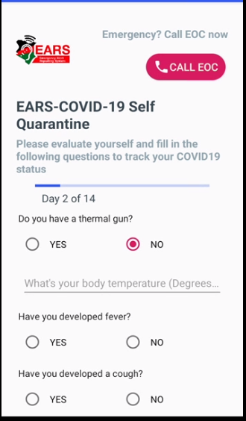
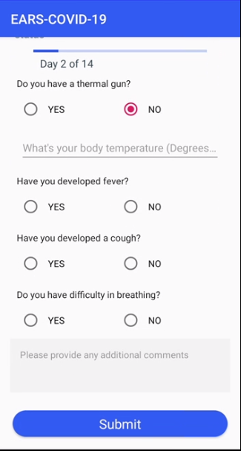
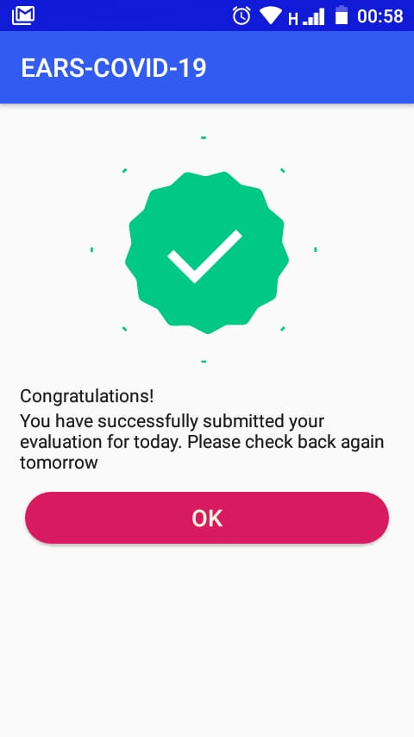
App-Based Monitored Self-Quarantine
Close contacts of confirmed cases receive an SMS with a link to download Jitenge app.
Upon download, Users are prompted by SMS to self-report on any constitutional symptoms of COVID-19.
This will be done daily during the quarantine period of 14 days.
An SMS is sent to the surveillance officers if a contact/quarantined person fails to respond.

Slide 7
Activities and Achievements
COVID-19 solutions re-used solutions developed for HIV:
Repurposed from solutions originally developed/adopted for HIV care
KenyaEMR, Community Health Toolkit, LMIS, Jitenge Emergency Alert & Response System (EARS)
Monitoring programs where movement is restricted:
COVID-19 solutions are centrally hosted enabling secure access to case-based surveillance data
Offline version of HIS (HIV & COVID-19) with periodic sync (daily when there is connectivity) in use
The National Data Warehouse allows monitoring of the HIV cascade

Slide 8
Activities and Achievements (continued)
Ensuring consistent data quality and reporting:
Standardized dataset for COVID-19 established by MOH, only MOH-approved forms used
System validation and involvement of end users
Data review with data management and oversight team
Data quality enforced through use of unique ID (National ID for adults and combination of Parent IDs for children)

Slide 9
Data Triangulation
Data Sources
Data Triangulation Activities
KenyaEMR COVID-19 Tracking System
Lab Information Management System
National Data Warehouse
Kenya Health Information System (DHIS2)
HRH Data
Master Facility Data (with geo-coordinates)
Census Data
Joint analysis of changes in reported respiratory infections (Source KHIS)
Modelling disease projections
Policy brief using National Data Warehouse
  Workload analysis at HIV clinics
  Adoption of multiple month dispensing to decongest HIV clinics

Slide 10
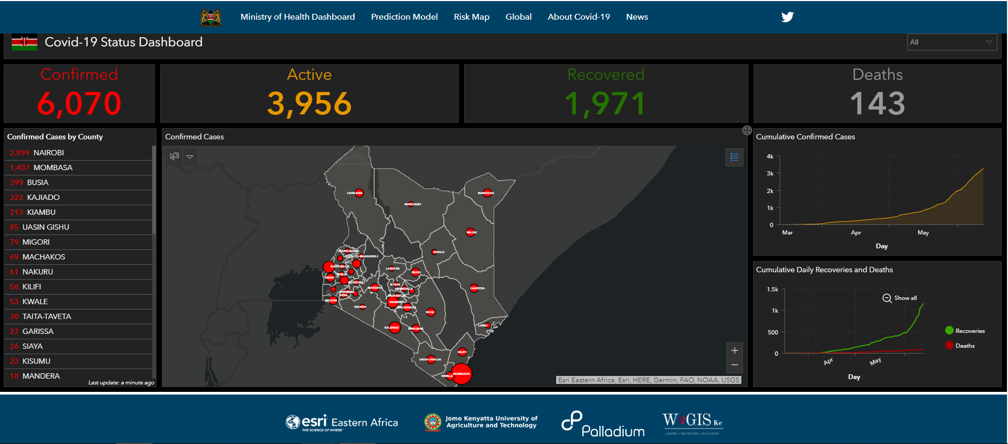
COVID-19 Tracking Dashboards
Developed in partnership with JKUAT
- 10 -

Slide 11
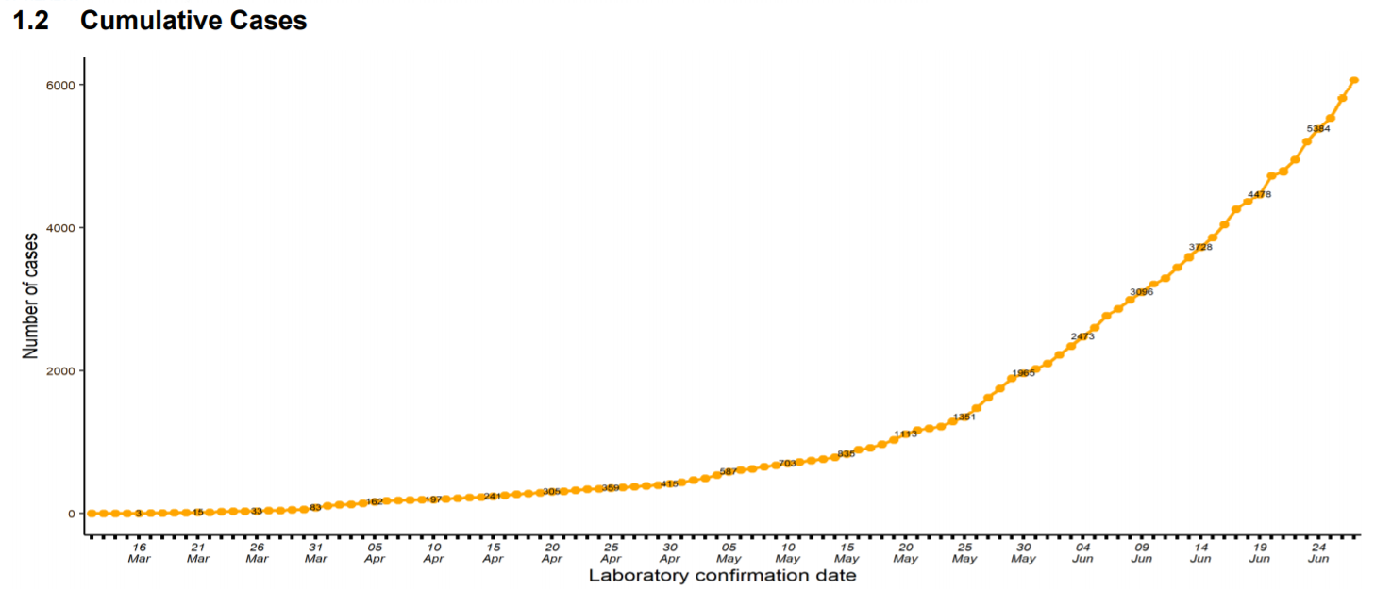
Cumulative COVID-19 Cases, 24 June 2020
Cumulative Case Load
Cumulative Case Load

Slide 12
COVID-19 Report Cases by County, 1 June 2020
Nairobi & Mombasa have a high number of cases

Slide 13
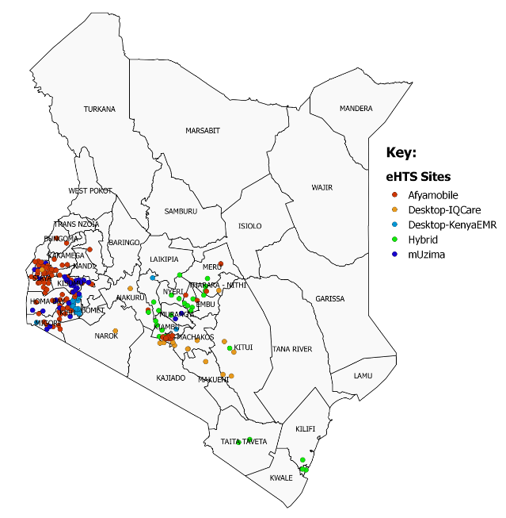
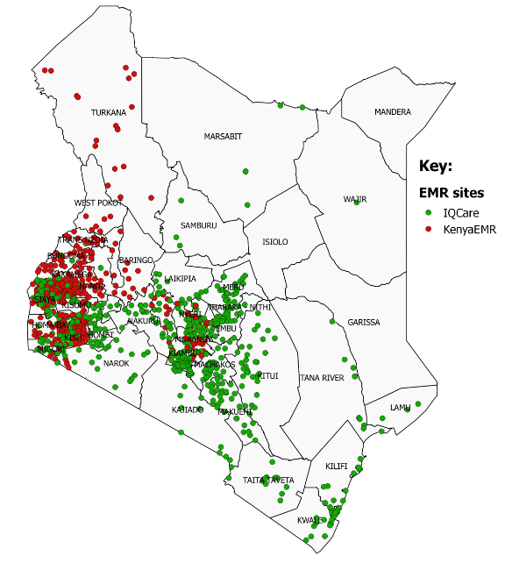
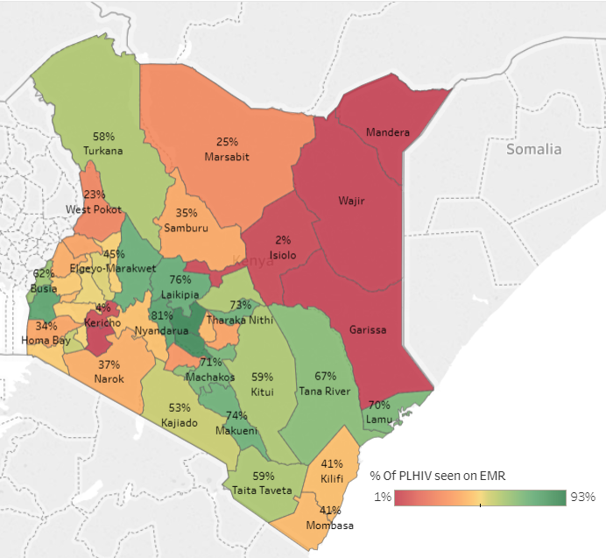
Data Review (COVID-19 and HIV) HIS Implementations for HIV Care
220
Health facilities using HIS for HIV testing services
1,114 EMR facilities
51%
Active HIV patients have data in DWH
372 KenyaEMR facilities

Slide 14
Distribution of Active HIV+ Patients on Treatment (N=652,337)
What is the risk of severe disease among HIV infected population?
Individual level (EMR) data from over 1,100 facilities is hosted in Kenya’s National Data Warehouse is providing some answers:
  Data warehouse has information for over 52% of HIV patients on ART
  HIV patients are getting older on average
    Over 40,000 are aged above 60 years
  A number of HIV+ persons have co-morbidities
  High HIV Viral suppression (~90%) is good news
*DWH is accessed at https://dwh.nascop.org

Slide 15
Appointment Duration by Age for Active and Stable Patients
Based on data from the National Data Warehouse, opportunities exist for scaling up Multiple Month Dispensing to decongest ART clinics and reduce risk of COVID-19 transmission.

Slide 16
On-going Activities
Support rollout of the COVID-19 surveillance system to sub-national units (counties)
Support MOH to transition to HIS for generation of daily Situation Reports
Analysis of co-morbidity data for HIV patients within DWH
Support for COVID 19 risk modeling and GIS-based hot spot analysis
Develop COVID-19 case management module in KenyaEMR
Continued remote technical support to HIV-centric digital systems

Slide 17
Lessons Learned So Far
Government leadership, ownership, and coordination is critical for sustainability
Rapidly evolving epidemic requires agility
Lessons learned from implementing digital health solutions for HIV control have been useful for COVID-19 response
Re-use and expansion of digital public goods (e.g., KenyaEMR) saves time, cost, and can transform the sector
Enhancements made for COVID-19 response will benefit HIV program:
  Inpatient care module for HIV patients
  Index and contact testing
  Evidence-based decision making across sectors and administrative levels

Slide 18
Acknowledgements
Ministry of Health, Kenya
World Health Organization
Palladium
Intellisoft
Medic Mobile
Clinton Health Access Initiative
Mhealth Kenya
Jomo Kenyatta University
CDC Kenya

Slide 19
Data.FI Nigeria
Pivoting on Technology for Seamless Delivery under COVID-19
Dr Dauda Sulaiman Dauda
Global Digital Health Network Monthly Meeting, June 29th,2020

Slide 20



Data for Implementation Nigeria
Goal: to accelerate and sustain access to high-quality data to expedite HIV epidemic control and maintenance.
USAID PERFORMANCE MANAGEMENT
high quality, compelling data made available to strategic information and health officers to ensure available resources are optimized for accelerated control of the HIV/AIDS epidemic in Nigeria
DATA ANALYTICS, VISUALIZATION & DATA USE
real time visualizations on the automated partner performance reporting (APPR) platform, granular programmatic analysis of the National Data Repository (NDR), census and electronic medical records’ data, and data from other sources with development of implementation science products
Epidemic Control Rooms
HEALTH INFORMATICS SYSTEMS DEVELOPMENT
ambitious programming to enhance various health information systems through strong Health information System (HIS) Governance processes and collaborative principles – LAMISPlus, APPR II, LIMS Integration

Slide 21

Akwa Ibom HIV/AIDS Situation Room

Slide 22
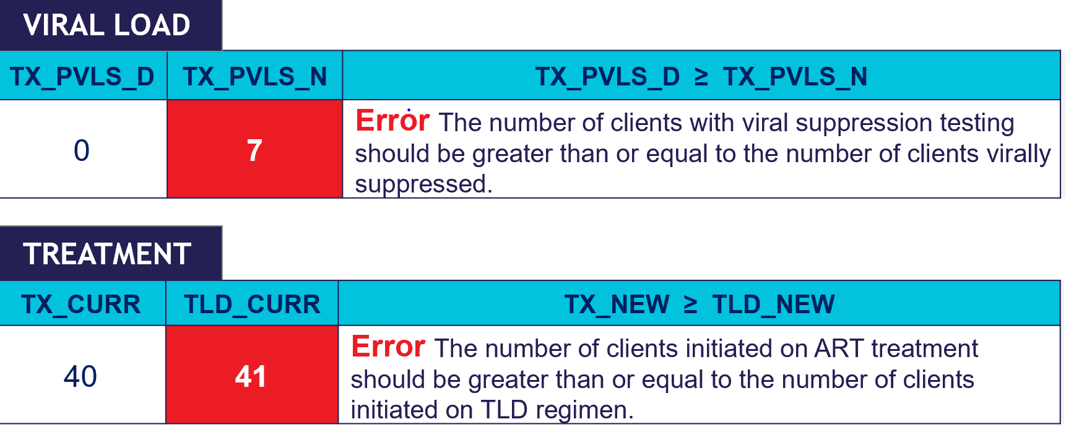


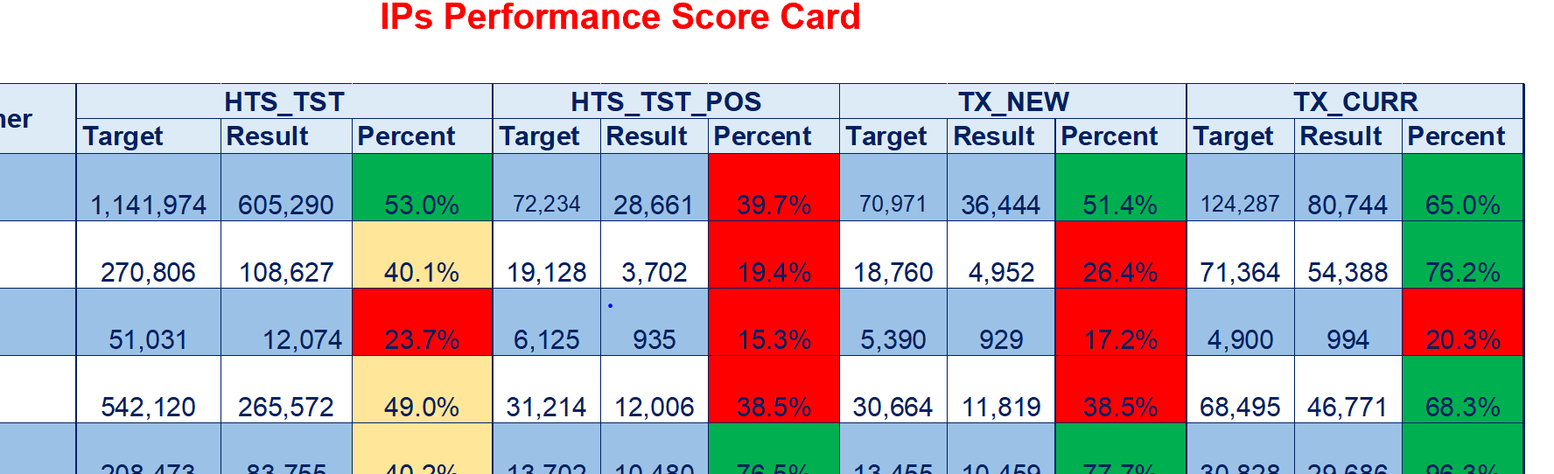
Shift to Remote Data Pulls
Automated the pull of aggregate data from implementing partners operating in different states in Nigeria. Through Web APIs we are able to seamlessly access data from the instances – OpenMRS, LAMIS
Institutionalized Remote Data Review - frequent webinars to provide feedback on performance data, data quality and aspects upload of data onto the NDRs. GoToMeeting and Skype as major means of collaboration
Engage IPs in weekly performance discussions to IPs by leveraging dashboards to identify high and low performing health facilities; APPR tableau dashboards are also being activated to provide more insight

Slide 23




Pivot to remote systems development
For LAMISPlus Development, we leverage a range of project management applications to ensure smooth communication and collaboration across Data.FI staff, implementing partners and regional technical experts despite quarantine conditions

Slide 24
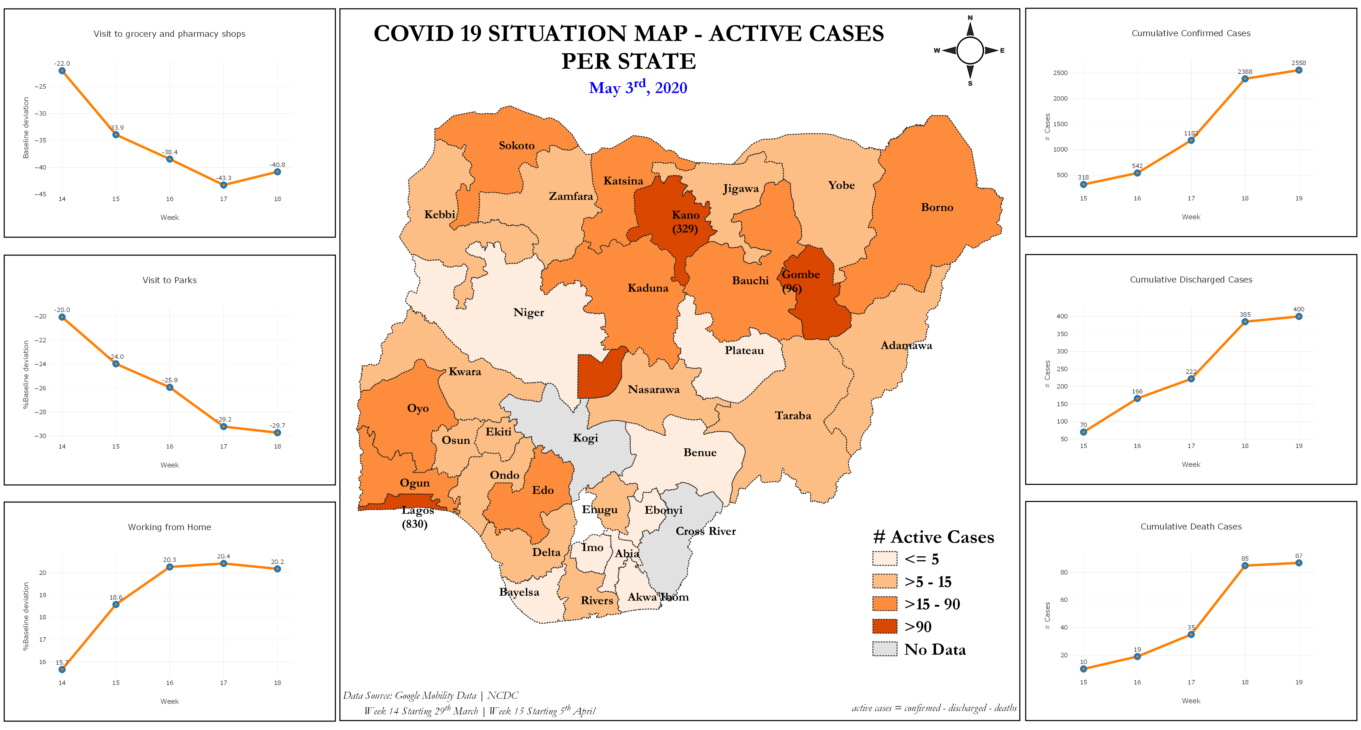
Data triangulation to visualize COVID-19 Impact
  The questions we seek to answer include linking mobility data to disease morbidity include:
    How quarantine measures impact transmission rates?
    How populations access to grocery shops, work places, transit stations, retail centers continue despite quarantine measures?
    How COVID infection rates impact the population access to health care facilities and HIV care and treatment services?
    PEPFAR (High Frequency Reporting & MER)
    Nigerian government (NCDC SORMAS & DPRS)
    Open Source data (Google Mobility & Facebook)

Slide 25
Data for Implementation (Data.FI) is a five-year cooperative agreement funded by the U.S. President’s Emergency Plan for AIDS Relief through the U.S. Agency for International Development under Agreement No. 7200AA19CA0004, beginning April 15, 2019. It is implemented by Palladium, in partnership with JSI Research & Training Institute (JSI), Johns Hopkins University (JHU) Department of Epidemiology, Right to Care (RTC), Cooper/Smith, IMC Worldwide, Jembi Health Systems and Macro-Eyes, and supported by expert local resource partners.
This presentation was produced for review by the U.S. President’s Emergency Plan for AIDS Relief through the United States Agency for International Development. It was prepared by Data for Implementation. The information provided [in this document] is not official U.S. government information and does not necessarily reflect the views or positions of the U. S. President’s Emergency Plan for AIDS Relief, U.S. Agency for International Development or the United States Government.

