Slide 1
How digital technologies can support self-care
July Meeting of Global Digital Health Network

Slide 2
Global Digital Health Network Meeting July 2020
Digitally-enhanced Self care: A Framework for Design, Implementation, and Research

Slide 3
Digitally-enhanced self care: Framework Overview
A descriptive framework and supporting reference material for program implementers, digital health developers and policy makers
Practical guidance on effectively designed, implemented and researched digital health in support of quality self-care
Guidance to accelerate, enhance, and measure the impact of digital self-care interventions

Slide 4
WHO Guideline: Digital as point of access and enabler

Slide 5
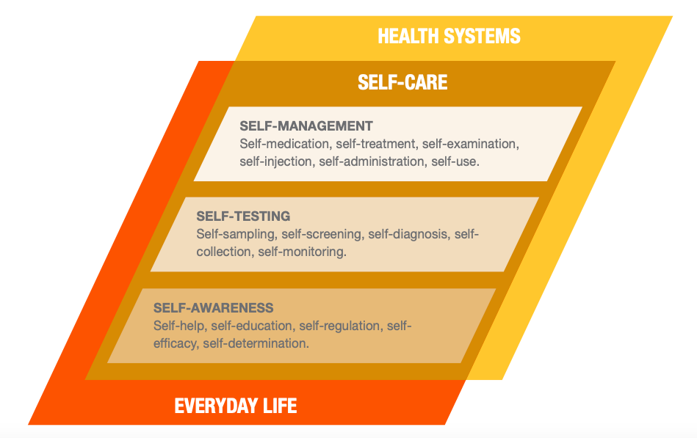
WHO Guideline: Self-Care and SRHR
Good Practice Statement 7: Digital health interventions offer opportunities to promote, offer information about and provide discussion forums for self-care interventions, including for SRHR
All recommendations that deal with aspects of health education, individual decision-making, self-assessment, and sensitization for individuals, communities and health care workers represent a potential intersection between self-care and digital health
Digital health can facilitate the delivery of health information that is accessible, reliable, useful and consistent with individual’s needs

Slide 6
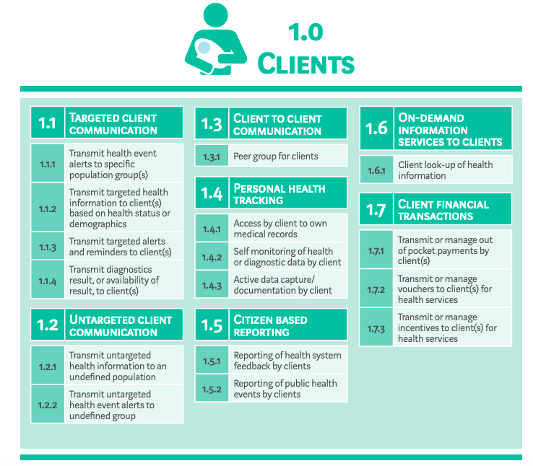
WHO Digital Health Guideline provides detailed recommendations on Targeted Client Communication &
Client to Provider Telemedicine (in the Healthcare Provider category). Almost all client related digital health approaches relate to self care.

Slide 7
Unique benefits of digitally-enhanced self care
Increased access to health information and services
Safeguarded anonymity and increasing autonomy
Linkages to the healthcare system for continuity of care
Personalized services
Continuous program monitoring for quality, safety and user satisfaction and impact

Slide 8
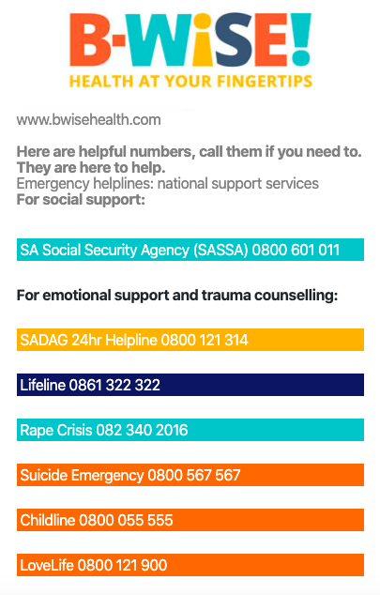
Major themes: Continuity of care & Linkage to healthcare providers
Jojo – Whatsapp chat with licensed clinician to ask questions and order contraceptives (Kenya, SH:24)
B-Wise and other education sexual health platforms offer links to live-chat or help lines with licensed professionals (WitsRHI, Aidsfonds and other partners in South Africa)
Notes:
These are the same issues and areas to consider for any self-care intervention, no different for digital
Self-care doesn’t mean all by yourself – essential to have some link to a licensed provider to answer questions, manage side effects, feel supported

Slide 9
Major themes: Safety & Quality
Samsara - medication abortion support app (Indonesia, Ibis RH) provided the same level of care as live-hotline counseling only – no differences in user reports of support and preparedness
Concerns over safety and quality, but digital platforms can provide a high level of control over messages and content and links to licensed providers
Eg. in-clinic web platform in South Africa (WitsRHI)

Slide 10
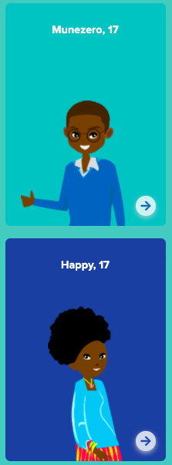
Major themes: Health literacy & self awareness Health
CyberRwanda - (Ylabs) - Gamified digital platform for youth to learn about sexual health through storytelling; includes information on career paths, finding jobs and also links to services
Sexual health education forms a foundation to build effective self-care

Slide 11
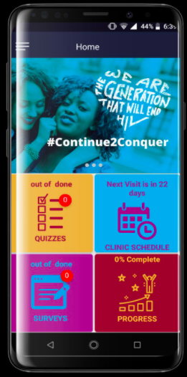
Major themes: Access & Equity
More than just “who has access to a mobile phone?”
Apps designed for new phones, incompatible with old models
Data-heavy downloads can limit access
Some people not comfortable with self-care or have data privacy concerns
How to reach the portion of the population who do not have access?
Notes:
Screen shot of the My Journey PrEP app from WitsRHI – they have been very mindful of creating apps that are functional on many device models, have very low data to download, and do NOT do frequent updates

Slide 12
Spectrum of Self-Care
High clinical complexity, risk
Low clinical complexity, low risk
Self-management, Self-medication, self-treatment
e.g. PrEP, self-injectables
Self-testing, self-monitoring
e.g. post-abortion self-assessment, HIV self-testing
Self-awareness, self-education, self-help
e.g. online sexual health education platform
More support
More Independence
Spectrum of Digital Health
Phone calls-SMS
Live Chat-Mobile Apps
Chat bots-AI
Low tech complexity
High tech complexity

Slide 13
Frameworks that fed into draft framework
WHO Consolidated Guideline on Self Care Interventions for Health: Sexual and Reproductive Health and Rights
WHO’s Classification of Digital Health Interventions
Organisation for the Review of Care and Health Apps (ORCHA) Review Criteria
Standards for Online and Remote Providers of Sexual and Reproductive Health Services (UK)
Quality of Care Framework for Self Care (under development- PSI)
Human rights framework for Self Care
Criteria for assessing quality health-related apps in the UK
Principles for Digital Development
A Vision for Going Online to Accelerate the Impact of HIV Programs (FHI360)

Slide 14
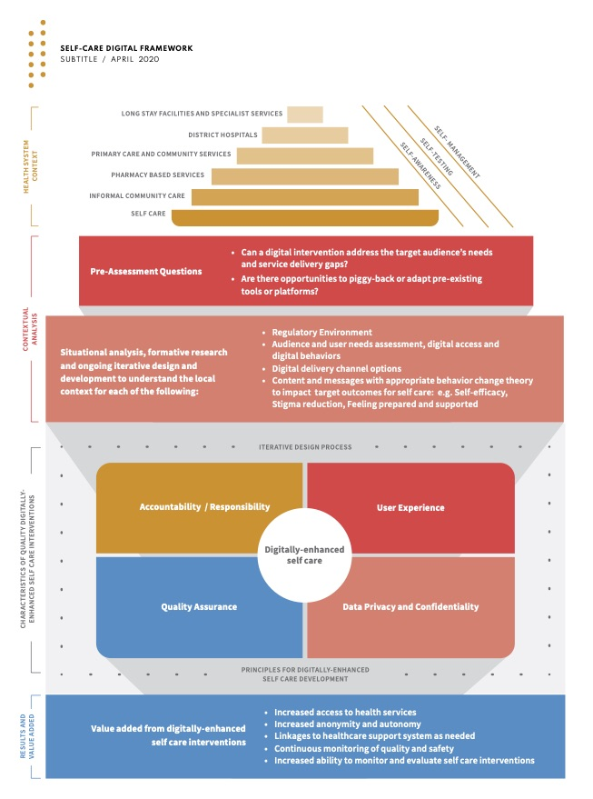
Draft Framework
Overall flow: Self care to context to iterative design (with prioritized considerations for implementation) to outcomes for research

Slide 15
Draft Framework:
Top line focus on selfcare at all levels of the health system
Designing if appropriate and within existing tools
Iterative design with focus on regulations, digital access & literacy, theory driven behavior change

Slide 16
Draft Framework:
Quality through prioritized characteristics driven by principles for digital development & iterative design
Leading to benefits of digitally-enhanced self care

Slide 17
Principles for Digitally-Enhanced Self-Care Development
Design with the User
Use Open Standards, Open Source, and Open Innovation
Be accountable to the user with priority on human rights, equity, privacy
Open source for the development of global goods and to facilitate interoperability with healthcare systems where appropriate.
Understand the Existing Ecosystem
Quality and safety supported by existing governing or regulatory bodies
Reuse and Improve
Content can be adopted for use in multiple settings and use delivery channels that are already in use by the prioritized populations
Design for Scale
Understand the health issues, infrastructure, and prioritized population’s digital access
Address Privacy & Security
Design for privacy and security in line with global best practices; consider the population’s comfort with sharing sensitive information
Build for Sustainability
Design to accommodate the volume and cost of services with relevant government and/or private sector stakeholders
Be Collaborative
Be Data Driven
Collaboration between digital providers and self-care providers with support from public sector policies, strategies and regulations
Data capture, collection and management must be balanced with the need for privacy and anonymity

Slide 18
Research Priorities
Evidence for government agencies to advocate for self-care digital applications: safe and consistent use, cost-effectiveness, impact of scale and reach
Can digital health mirror the quality and safety of an in-person interaction – how to develop quality clinical relationships and communication online?
How do online and digital use patterns differ from in-person care?
Empowerment and self-efficacy – How can this be measured? What is the contribution of self-care?

Slide 19
Thank You & Next Steps
Many thanks to the Self care Trailblazer Group for their inputs and guidance throughout the process.
Next steps:
Draft is currently being updated based on feedback from the Self care Trailblazer Group
Aiming for design in mid-August
Release/ launch – August/ September 2020
For more information contact patty@healthenabled.org

Slide 20
Self-Care through an Ecommerce Platform for Women’s
Health & Personal Care in Africa
July 2020
Natacha MUGENI, Health Coordinator
natacha@kasha.co

Slide 21
Kasha Overview

Slide 22
Kasha is a Direct-to-Consumer Ecommerce & Insights Platform Built for Low-Income Countries
Online & Offline Ecommerce
Optimized for Self-Care Products
Last Mile Delivery to Urban and Rural
Rich Consumer & Market Insights

Slide 23
How customers order on Kasha
Basic Feature Phone
Dial *911# Rwanda or *308# Kenya
Kasha Website Kasha.rw & Kasha.co.ke
Mobile
Call Center Phone, SMS, WhatsApp
& Social Media
Internet access or smartphone not required to browse through products, order and pay. Toll free. Localized for multiple languages.
Multiple payment options.

Slide 24
What Kasha sells
Menstrual Care – wide variety from pads, tampons, cups, etc.
Pharmaceuticals – Selfcare products such as contraceptives, HIV Self-Tests, Pregnancy Tests, General OTC and prescription medication
Personal Care - lotions, soaps, face and hair products
Mom & Baby Care – Pregnancy related, Diapers, Nursing support, etc.
Beauty and Make-up Products
We also offer Telemedicine phone consultations with registered nurses and doctors

Slide 25
Popular self care products
Popular self care products
Menstrual Care – wide variety from pads, tampons, cups, etc.
Soaps and lotions
Contraceptives such as emergency contraceptives, condoms
HIV self-tests
Pregnancy tests
What more?
Information
Packaging
Last mile delivery
Variety of products
Affordable price for low and middle income communities

Slide 26
Kasha’s prescription pharmaceutical ordering process

Slide 27
Last mile delivery - How Kasha delivers to urban and rural
Direct Delivery
Kasha Pick-Up Points
Kasha Agents
Urban Only
Urban and Rural
Urban and Rural

Slide 28
Thank You

Slide 29
SMART Connections Social Media to improve ART Retention and Treatment Outcomes Among Youth Living with HIV in Nigeria

Slide 30
Background
YLHIV, ages 15-24, experience higher loss to follow up (LTF) and poorer adherence than adults
Less likely to remain on treatment at 12 months after starting
More likely to experience treatment disruptions
YLHIV experience many challenges with adherence and retention
Fear of stigma or disclosure to others
Lack of social support
Limited knowledge about the disease
Barriers to clinic-based care
Distance
Poor provider attitudes
Fear of being recognized
Mobile population (may be away from home clinic for school or work for extended periods of time)

Slide 31
Intervention
Designed to improve HIV-related knowledge and enhance social support
Adapted existing educational guide content to online platform
Enrolled YLHIV in groups of 15-25, by geographic region
Delivered content and facilitated group discussions through social media platform

Slide 32
How It Works
Safe Space: YLHIV ages 15 to 24 form “Secret” Facebook groups.
Supportive Adult Role Model: Led by trained adult facilitator with lived HIV experience.
11 Topics Covered: Understanding HIV; Treatment & Adherence; Disclosure; Exploring Feelings; Nutrition & Health; Reproductive Rights; Positive Health Dignity & Prevention; Stigma, Discrimination & Rights; Violence; Communication & Problem Solving; Planning for your Future.
Interactive Polls and Facilitated Discussions test knowledge and reinforce learning.
Word-of-the-Week and Key Message images provide definitions of core concepts.
Social Activities including riddles, puzzles, and discussion about non-health topics to promote bonding.

Slide 33
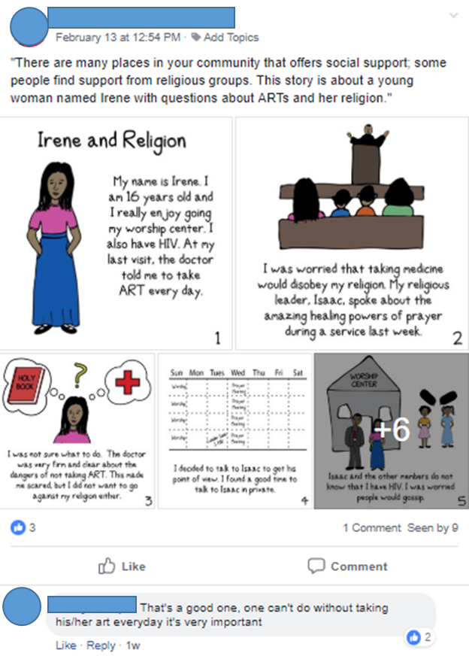
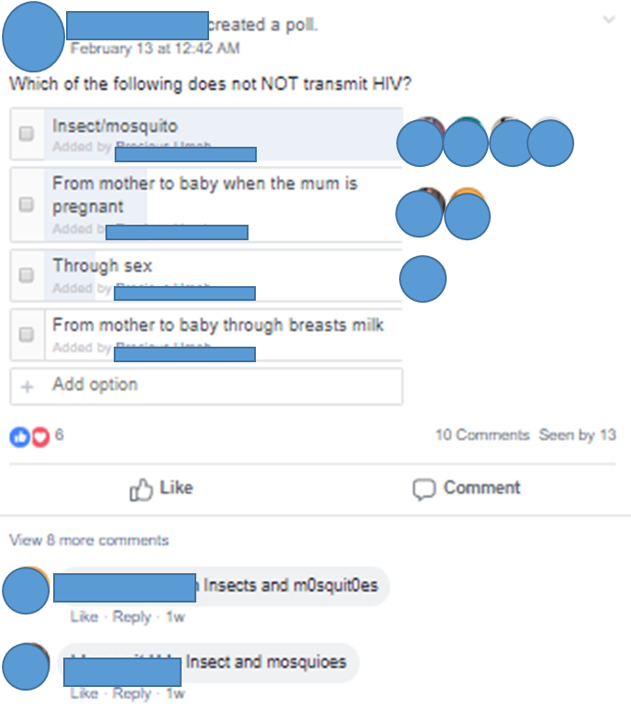
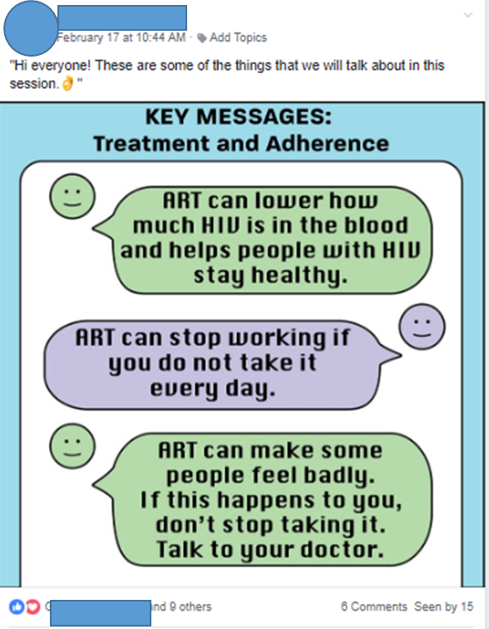
Informational Messaging:

Slide 34
Two Phase Study
Aim: To generate evidence on an intervention designed to improve retention in HIV care services among YLHIV, ages 15-24 years, recently enrolled in ART services.
Phase 1: Feasibility pilot study
Determine feasibility and acceptability of intervention among AYLHIV
Phase 2: Outcome Study
Test the effectiveness of the intervention to increase retention in HIV services among YLHIV using Facebook.
Examine the effect of SMART Connections on secondary outcomes of social support, HIV knowledge and treatment literacy, and ART adherence among YLHIV.

Slide 35
Feasibility Results
“I am a very timid and shy person. But the intervention helped me. There are certain things I was able to overcome. I felt so miserable when I found out that I’m positive but after interacting with people, I find out that I don’t have to kill myself or die or feel miserable …So I have decided to open up and feel good about myself.” - 18-year-old female
94% who completed an endline questionnaire felt that accessing the intervention on Facebook through their study phone was easy
The majority of YLHIV said they prefer an online-only support group compared to an in-person group because there are no travel-related costs or logistical barriers
All agreed the intervention was useful, enjoyed taking part in it, felt comfortable with the facilitator and group members, and wanted to continue the intervention
YLHIV reported the group was informative, enjoyed sharing experiences with other YLHIV, felt encouraged and supported them to take care of themselves
All participants said they would recommend the intervention to other YLHIV

Slide 36
Outcome Study
Statistically significant improvements in HIV-related knowledge
Participants reported that the intervention was useful, that they enjoyed taking part, and that they would recommend it to other YLHIV
No statistically significant differences for ART adherence, retention or social support were found
Retention at endline overall was high in both intervention and control groups and may reflect simultaneous external efforts

Slide 37
Qualitative Comments
Um, it’s, it was more easier than we going for our meeting…you just wake up in the morning, check if there’s a message or a post dropped , then you just also give your own contribution, and then you logged out… It was very, very easy so that was the only and it makes some things look so secret because going out for meetings, one day our parent will be asking you ‘where are you going to’? – 21-year-old female
…initially, when I started the drugs…I was always feeling dizzy, drowsy, very weak at times, vomiting and generally pains. Something like that and I couldn’t eat. …So I wanted to at a point stop taking the drug, but since (GROUP) came up and told me that I should continue taking the drug, that very soon, the drowsiness will stop and it did stop and I’m very happy now. – 17-year-old female

Slide 38
Recommendations
Consider pairing self-care interventions as an enhancement to existing in person services—particularly for groups with complex needs
Consider the role of peers and online mentors
Also consider how digital can be leveraged to reach parents, partners, and other supportive family members as a compliment to efforts to reach target population
Real-world implementation where participants opt-in to the intervention and make use of their own existing phones and network services should be tested

Slide 39
Conclusions
Broadly speaking, the needs of YLHIV continue to go largely unmet, despite being among those at highest risk of adverse outcomes from HIV
Efforts to meet those needs must address not only health, but the broader informational, psychological, social and developmental needs specific to this age group
Using tools familiar to the younger generation of adolescents and young adults can be an effective way to engage youth, to share information and to let them know they are not alone in their experiences
While this intervention met specific needs that were not being addressed in the clinic setting, self-care is just one piece of a broader comprehensive package of services for this population

Slide 40
Q&A

