Slide 1
Elements of building a sustainable and strong national Health Information System
Romain Tohouri
Alex Tumwesigye
Sarah Andersson
Tariq Azim
Global Digital Health Network
January 2020 Monthly meeting
Jan 9, 2020

Slide 2
Agenda
DHIS2 experience
RHIS eLearning curriculum
IMPACT Teams

Slide 3
Center for Digital Health
Health Information Systems
(HIS)
Data Services
Mobile Solutions
Technology for Logistics
Channeling Content
Building Blocks

Slide 4
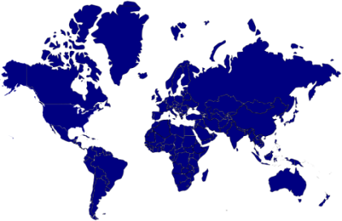
Our Team
15
275+
Our Team
Members
Members
Core Team
Extended Team
What we do
We help projects ensure success by promoting best practices through:
Technical assistance
New business development
Learning opportunities & guidance

Slide 5
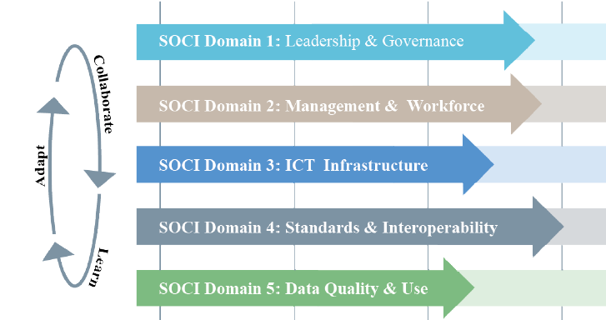
Stages of Continuous Improvement
Adapted from HIS Stages of Continuous Improvement Toolkit
Notes:
Today we will touch on Domains 2, 4 and 5 but recognize that all domains are needed for effective HIS

Slide 8
Leveraging JSI internal DHIS2 capacities
We supported National DHIS2 implementation in 16 Countries
Our DHIS2 team and work to date
The JSI DHIS2 core team:
Bringing together DHIS2 expertise from HQ and field projects
Variety of profiles
Developers
Interoperability experts
HMIS implementers
Data visualization specialists
What we have done
ECHO - DHIS2 as a service for JSI projects
HFR data management system
Aggregate data collection workflow design (Zambia SAFE project)
Tracker based data management system (Ghana Continuum of Care project )
DHIS2 based Rwanda dashboard
DHIS2 based Facility Registry app in Guinea
One-health system in Burkina Faso
Data Migration from legacy system to DHIS2 in Madagascar and Burundi
DATIM data import, MOH data alignment and OrgUnit hierarchy site changes
Notes:
Burundi, Cote d'Ivoire, Ethiopia, Burkina Faso, Guinea, Liberia, Mali, Namibia, Tanzania, Madagascar, South Africa, Zambia, Senegal, DRC, Nigeria, Rwanda

Slide 9
Beyond DHIS2 native capabilities
Highlights of our work
When DHIS2 cannot address all the needs we develop a specific app
Contribution to DHIS2 community
Interoperability layers (Burkina Faso and Mali)
Drupal to DHIS2 connector
Data import scripts for legacy data migration
HIS Maturity models tool
ICT Infrastructure Assessment tool
JSI developed custom apps:
HFR import / export app
Facility Registry app (Guinea, Mali, Burundi)
Rwanda Dashboard

Slide 10
DHIS2 Continuum

Slide 11
DHIS2 Continuum domains
Advocacy for investment
Assist: Advocacy/marketing
Tech: demo DHIS2 instances
Stakeholder engagement
Assist: Actors & donors coord.
Tech: IT solutions readiness
Planning for DHIS2 rollout
Assist: DHIS2 WP/ Curriculum dev
Tech: Infrast. / contextualization
Business process analysis & requirements
Assist: info workflow /BP def.
Tech: HIS Architecture blocks impl.
DHIS2 configuration
Assist: Management procedures
Tech: Procurement, customization
Build local capacity to use DHIS2
Assist: train DQ, Viz, entry, analysis
Tech: training means innovation
Promote data use
Assist: data triangulation, viz & use
Tech: Custom dashboard, viz apps
Evaluating success & ongoing country support
Assist: Sharing learning & best practices, monitoring & supervisions
Tech: Security audits, further interop

Slide 12
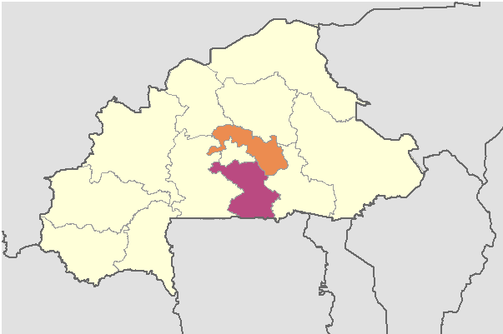
Strengthening One Health
Burkina Faso

Slide 13
What is the context? Human and animal health
Aftermath of Ebola and other highly-pathogenic infectious diseases and zoonoses epidemics in West Africa
Need for an integrated approach to human and animal disease surveillance
One-health zoonotic disease prioritization for multisectoral engagement workshop (2017) agrees on 5 priority zoonotic diseases: anthrax, rabies, brucellosis, highly-pathogenic avian influenza (HPAI), and dengue
MEASURE Evaluation begins in March 2018 under Global Health Security Agenda

Slide 14
Why use DHIS2 to build an HIS?
DHIS2 already used by Ministry of Health (MOH)
Ministry of Livestock and Fisheries (MRAH) using a Microsoft Access-based system
Ministry of the Environment (MEEVCC) had no information system in place
An integrated system was needed to track animal and human diseases across 3 independent ministries from community to national level

Slide 15
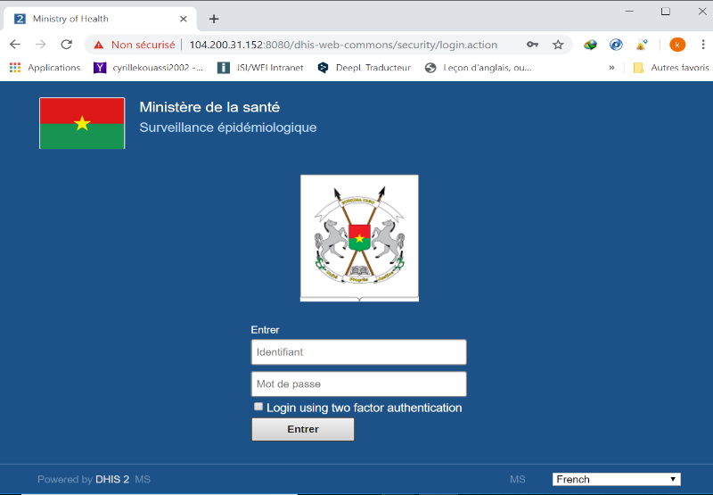
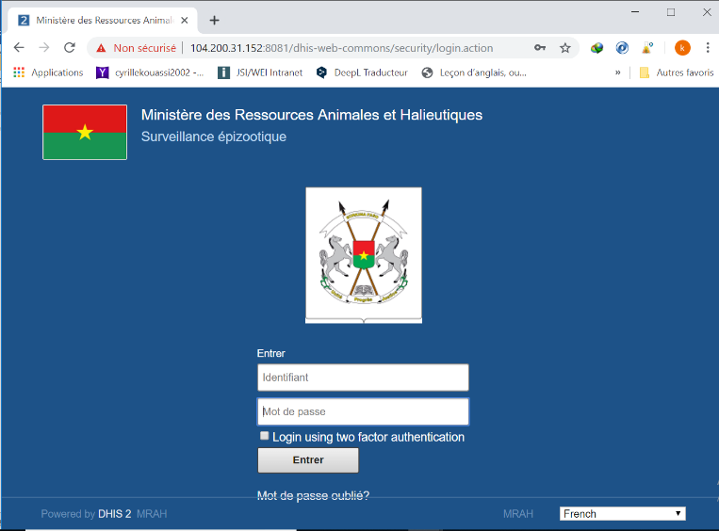
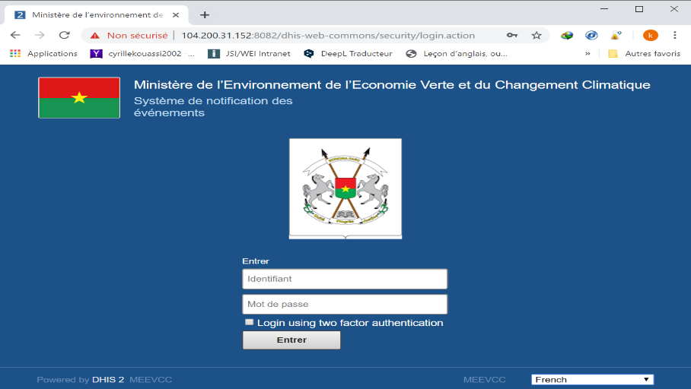
One Health Platform “instances”

Slide 16
One Health Process
Rumor management
Rumor investigation
Follow-up with cases
Form – Notification of unusual events:
Description of event
Type of event (classification)
Details on the event
Form–Investigation/RESUREP:
Investigations on events
Observations
Action
Sensitization
Tracker – IDSR/SIMR :
Information on the case
Sample transportation
Lab analysis results
Follow-up with cases
Contact tracing

Slide 17
What? Where?
 | MOH | MRAH | MEEVCC
Other diseases* tracked via One Health platform | 52 | 76 | 3
* aside from the common five priority zoonoses: anthrax, rabies, brucellosis, HPAI, and dengue
Center-South Region
(March 2018 – present)
Central Plateau Region
(June 2019 – present)

Slide 18
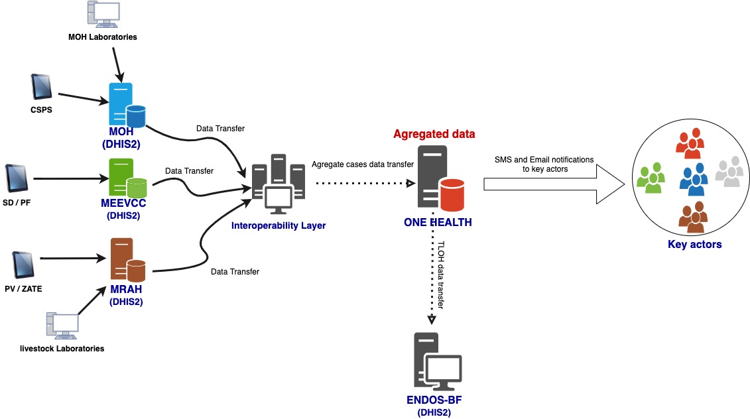

Slide 19
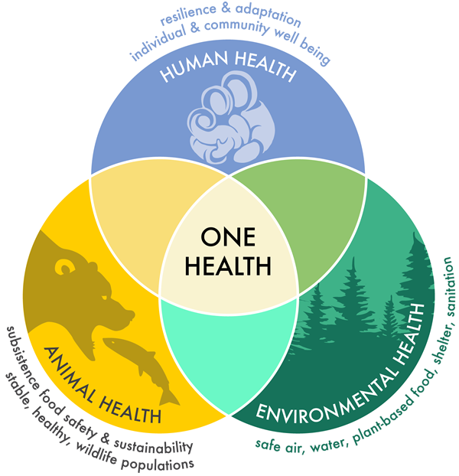
Promising practices for multisectorality
Governmental decree establishing
the One Health platform
Interministerial decree committing to use the One Health electronic system signed by all ministries involved
Event-based surveillance and field epidemiology training involving three ministries and their community workers
Holistic view of public health threat from three ministries’ perspective

Slide 20
Challenges
Keeping community workers motivated through appropriate incentives, training, and equipment
Continued support to integrate all existing information systems in the One Health electronic system
Sustained monitoring of collaboration mechanism functioning to maintain and improve stakeholder communication
Ensure sustainability of the One-health Infrastructure by clearly defining it the government budget
Ensuring adequate organizational capacity in the three Ministries

Slide 21
Future Directions
Integration of existing ministries’ disease surveillance systems in a One Health data warehouse
Holistic view of public health threat from three ministries’ perspective with live dashboards and real time notifications
Training of animal resources and environment staff in field epidemiology
Collaboration by the Government of Burkina Faso and donors to support One Health at all levels of the health system

Slide 22
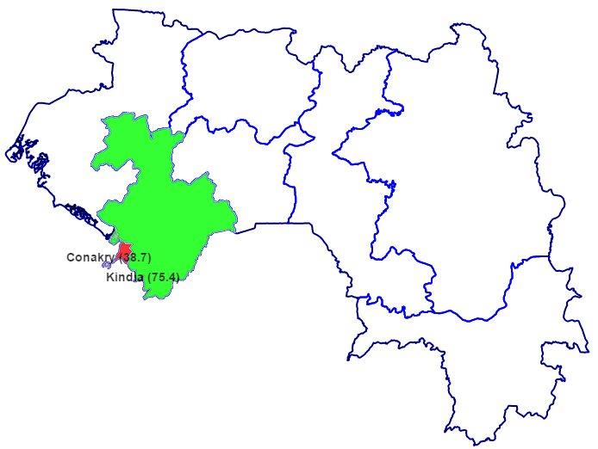
Strengthening the National RHIS
Guinea

Slide 23
Why DHIS2 as a national RHIS?
State of the country as of January 2016:
Post Ebola, nonfunctional health information system (HIS) electronic platform, irregular data reporting, and no legacy data
No HIS strategic plan or costed strategic plan
Weak coordination mechanism
Lack of guidance documents
Low technical capacity of the health management information system (HMIS) staff

Slide 24
A gradual collaborative approach (DHIS2 Continuum)
Strengthening collaboration and partner engagement
Creation of the HMIS technical working group (TWG)
DHIS2 implementation project document
DHIS2 implementation stakeholder engagement matrix
Development of a national master facility list (MFL)
Implementation of a multidisciplinary national DHIS2 core team
Coordinated national roll-out

Slide 25
Achievements
Implementation
Capacity building through DHIS2 trainings
Collaborative nationwide deployment in one year
Governance
National HIS strategic plan and SOPs
HMIS guidance documents
Disaster recovery plan
Data quality and use
Country-hosted servers
HMIS curricula and supervision tools
HMIS and IT infrastructure
Country-hosted servers
DHIS2-based facility registry application

Slide 26
Achievements
Implementation
Capacity building through DHIS2 trainings:
Design and customization for national DHIS2 team
Data entry, analysis, and use for decentralized staff
DHIS2 for decision making for high-level MOH staff
Collaborative nationwide deployment in 1 year:
8 health regions (100%) and 38 health districts (100%)
33 district/regional hospitals (100%) and 2 national hospitals (66%)
6 communal health centers in Conakry (100%)

Slide 27
Achievements
Governance
National HIS strategic plan
National costed operation plan
HMIS guidance documents
Data review meetings at national and regional levels
Disaster recovery plan
System maintenance standard operating procedures (SOP)

Slide 28
Achievements
HMIS and IT infrastructure
National DHIS2 fully configured and available online
Local production server installed and fully configured in local data center
Backup server installed at the MOH with power backup management system
Automatic encrypted data backup system
Advanced security monitoring systems and maintenance tools implemented
DHIS2-based facility registry application

Slide 29
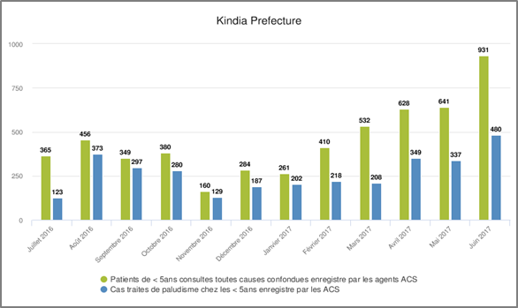
Achievements
Data quality and use
National and regional bulletins
HMIS/leadership curricula and championship
HMIS supervision tools (set of three)
Data validation SOPs across all levels

Slide 30
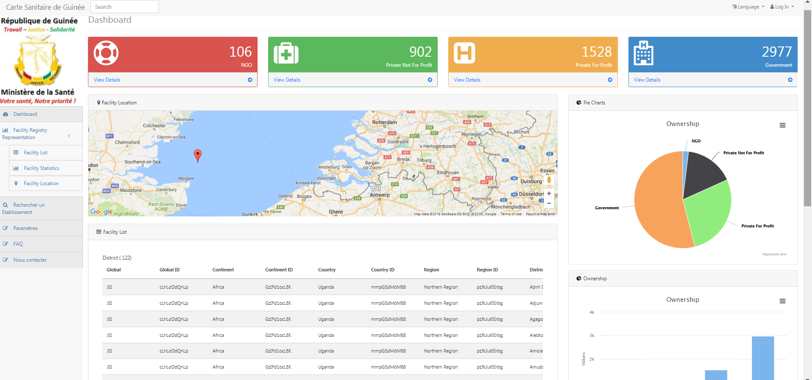
DHIS2 Based Facility Registry (MFR app)
Facility Registry Representation
Facility List
Facility Statistics
Facility Location
Dashboard
Find your Facility
Export MFR (pdf,csv)

Slide 31
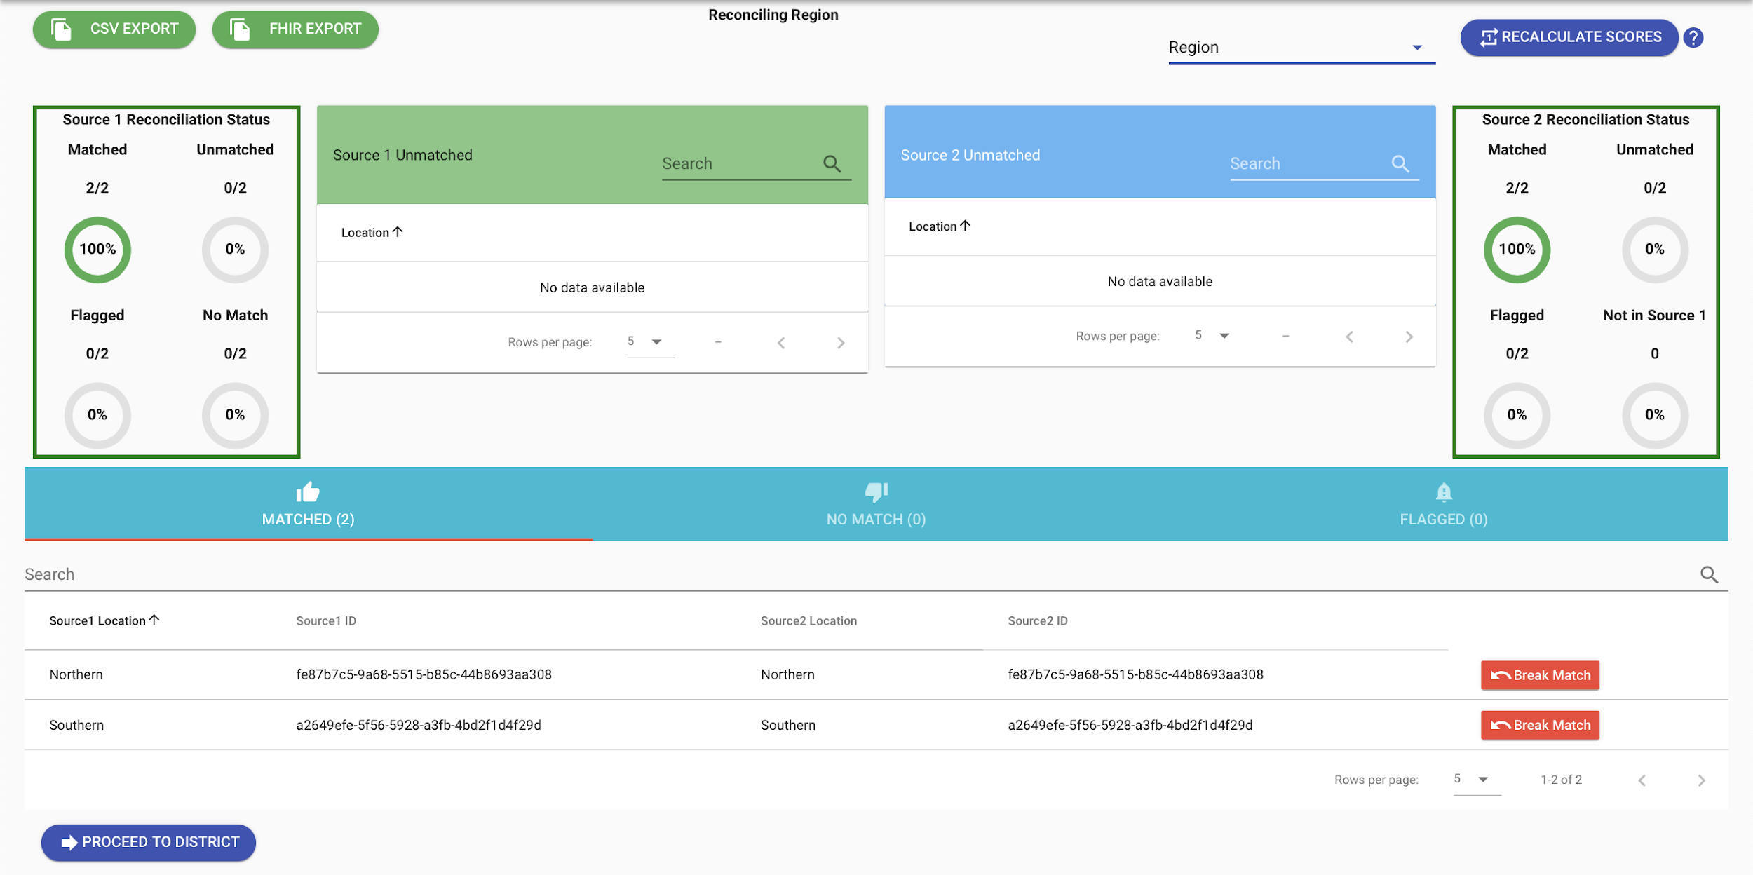
JSI MFR app and GOFR global good
In Guinea JSI and partners supported the implementation of the GOFR project resulting on:
Use of DHIS2 and MFR app as National facility registry / MFL
Translation of the GOFR deduplication tool in French
Development of Facility Registry data management SOP

Slide 32
Challenges
Sustainability for Internet provision for servers and users
Coordination of partners and actors for replication of MEASURE Evaluation/JSI methods and tools in the rest of the country
Keep the momentum after the end of the project

Slide 33
Epilogue
DHIS2 still in use and healthy despite end of MEASURE Evaluation/JSI project
IT infrastructure still working well and responding to country needs
MEASURE Evaluation facility registry functionality improved with the addition of the Global Open Facility Registry (GOFR) project deduplication tool
Facility registry management document developed and used by the MOH
MEASURE Evaluation/JSI’s work has set the foundation for a resilient RHIS in Guinea

Slide 34
Lessons learned
DHIS2 Hosting (Cloud versus on-premise)
Customization of tools or forms e.g HMIS
Implementation and Rollout
Training and capacity building (modular versus adhoc)
Coordination of efforts to implement HMIS systems
Data sharing and data use (Facility registry and Coding – terminology services)
In country capacity (DHIS2 Management)

Slide 35
Lessons learned – DHIS2 Hosting
Hosting (Cloud versus On-premise)
Cloud preferred
Server management load reduced
Countries have privacy and data sharing laws
On-premise
Lack of capacity to manage data centers
Backup and recovery routines/Disaster Recovery Sites
Cost for acquire and maintain the data centers in country

Slide 36
Lessons learned – Customization of tools
Tools or forms not harmonized
Multi data collection forms for specific programs or IP
Common elements, disaggregations, etc not standardized
Activity or funding based tool designs
Addendums to tools not allowed in HMIS guidelines
Disaggregations changes
Upgrading DHIS2 data collection forms becomes complicated
PEPFAR disaggregations not aligned to MOH (PEPFAR changes every year, MOH every 5 years)

Slide 37
Lessons learned – Implementation and Rollout
Separate training, development and production instances
Develop a rollout plan
Phased approach
Start with districts where connectivity is available
Emphasize use of online data entry
Use DHIS2 Android App only for targeted cases (Limited connectivity, hard to reach, etc)
Avoid standalone DHIS2 Instances
Data migration/sharing gets messy
Data quality and data cleaning

Slide 38
Lessons learned – Training and capacity building
Limited capacity to train users exist within countries
HISP communities assist but are business entities
Implementing Partners support ad hoc trainings (attributed to availability of funds)
Targeted modular trainings most effective (Data entry, Analysis, GIS, etc)
Lack of coordination (MOH-TWG should coordinate)

Slide 39
Lessons learned – Governance/Coordination
TWGs exist but not well coordinated to guide IPs during DHIS2 implementation activities
Need for work plan dedicated to support HIS (DHIS2)
MOH IT teams not making Technical decisions especially making changes to DHIS2 metadata
Define Data Management and Systems Operations roles
Parallel reporting systems existence (even where DHIS2 platform is the sole data repository)

Slide 40
Lessons learned – Data Sharing and Data Use
Ensure Facility Registry availability and accessibility
Create terminology service (Data elements not standardized)
Create Data repository for data sharing
Integrate all data sources to one warehouse
Standardize Dashboards
Define HIS Architecture to facilitate HIS integration

Slide 41
Lessons learned – Data Sharing and Data Use
Define Access control and rights
Not all data collected is used for decision making
Limited capacity on how to use data at lower levels

Slide 42
Lessons learned – In country capacity
Limited DHIS2 expertise
MOH relies on partner support (Salaries are low at MOH)
MOH HR manuals do not include HIS personnel

Slide 43
Future Priorities
Continue contributions to Global Goods
Continue development of Android /mobile DHIS2 capabilities
Continue strengthening DHIS2 user community
Promote the dual approach of the JSI DHIS2 continuum:
-> DHIS2 technical implementation has to go hand in hand with system strengthening

Slide 44
RHIS eLearning Curriculum
Why RHIS Curriculum
Strong RHIS essential for health program managers to monitor, evaluate, and improve health system performance and make evidence-informed decisions.
Limited RHIS capacity - a root-cause of poor RHIS performance
RHIS Curriculum to help build the capacity of health managers and staff
Why e-Learning
Shown to increase learning retention while decreasing overall training time
Interactive online courses are globally accessible, easily updated, standardized, can be downloaded and completed offline, including on mobile devices, making content available anytime, anywhere.
Minimizes time workers are away attending workshops, eliminates travel costs.

Slide 45
RHIS eLearning Curriculum
RHIS Curriculum
A global product - developed by MEASURE Evaluation in collaboration with many organizations including WHO
The syllabus, curriculum, training guides and slides available on MEASURE Evaluation website (https://www.measureevaluation.org/our-work/routine-health-information-systems/rhis-curriculum)
In high demand - RHIS Curriculum downloaded over 8,000 times
RHIS e-Learning
Shown to increase learning retention while decreasing overall training time
Interactive online courses are globally accessible, easily updated, standardized, can be downloaded and completed offline, including on mobile devices, making content available anytime, anywhere.
Minimizes time workers are away attending workshops, eliminates travel costs.

Slide 46
RHIS eLearning Curriculum
RHIS e-Learning
Developed under the APC / HMIS Scale-up Project, Ethiopia ; 23 staff received training using these modules
These eLearning modules allow for self-paced learning by staff in remote places; can also be used in classroom setting
Currently available on JSI E-Learning Center website; (https://elearning.jsi.com/);
Free for anyone to use; any organization can have these on their own LMS/website

Slide 47
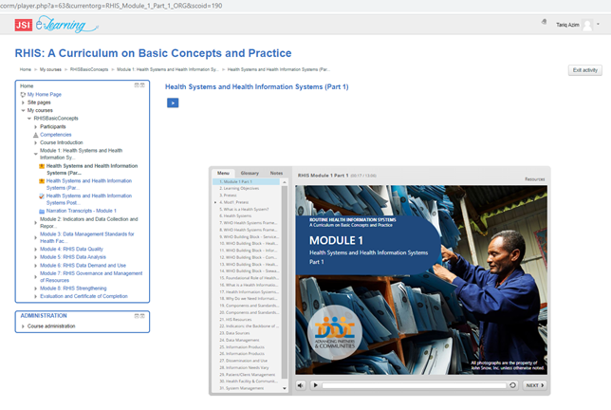
RHIS eLearning Curriculum
Routine Health Information Systems

Slide 48
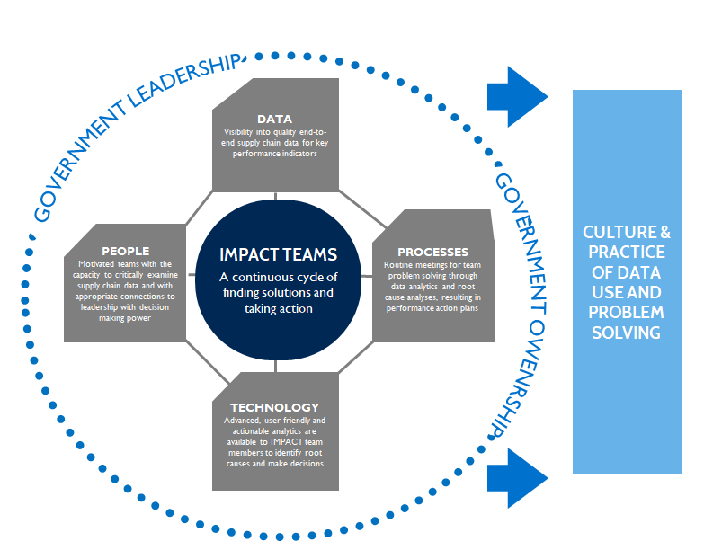
IMPACT TEAMS
Notes:
Significant investments have been made in building and automating health logistics management information systems (LMIS). These efforts have resulted in greater availability of real-time supply data. However, data availability alone is not sufficient to strengthen systems. A critical gap remains in the use and usability of this data, particularly at the subnational level.
IMPACT teams work to strengthen the use of data by focusing on people and process, and connecting them to data and technology. This TOC demonstrates what in our experience is critical components to ensuring data is used for continuous improvement.

Slide 49
History
IMPACT Teams emerged from implementation research in Ethiopia, Malawi, Rwanda
Originally derived from quality improvement approaches, adapted for supply chains but not limited to supply chains
Implementation research: improved supply reliability, communication and trust
Because of results: expanded scope & implemented in multiple countries
IMPACT stands for:
Information
Mobilized for
Performance
Analysis and
Continuous
Transformation
towards supply chain excellence
Notes:
•IMPACT Teams were originally derived from QIT approaches, adapted for supply chains
•Implementation research shows that they achieve improved lead times, product availability and supply reliability (over and above eLMIS)
•These results compelled us to expand the scope and implement in multiple countries

Slide 50
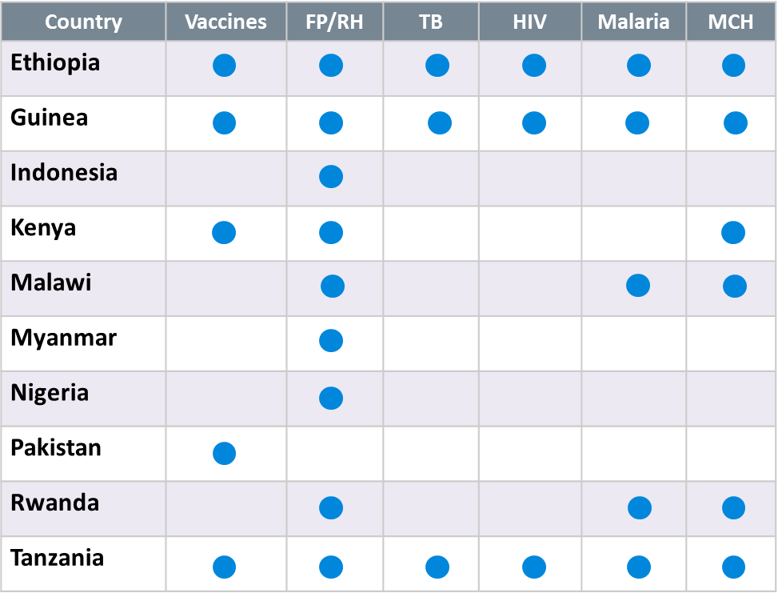
Global Reach
JSI has implemented IMPACT Teams in 10 countries, across programs and health system levels
Notes:
JSI and inSupply Health in Kenya have implemented IMPACT teams in over ten countries in Africa and Asia.

Slide 51
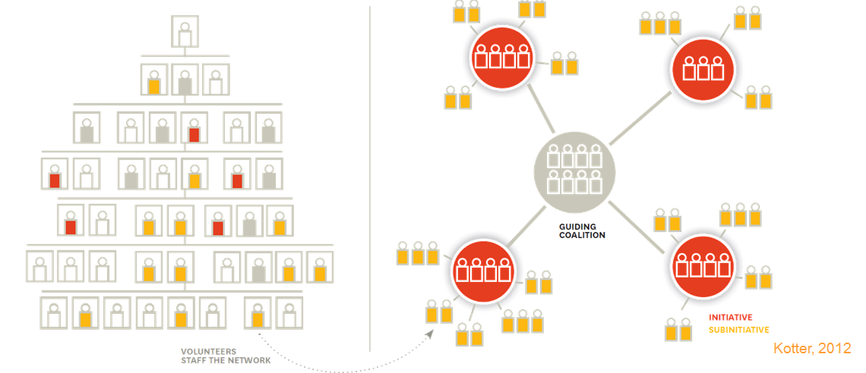
Health System Reach
IMPACT Teams are a system of interconnected teams, made up of people across functions and disciplines
Notes:
IMPACT teams create innovation hubs that connect different levels of the system and can break down some of this hierarchy. Teams across the health system have a common goal and a commitment to addressing supply chain challenges together. IMPACT Team membership is purposefully multidisciplinary which is critical for identifying root causes and finding holistic, creative, local solutions.

Slide 52
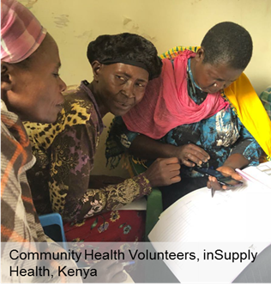
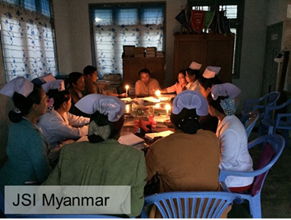
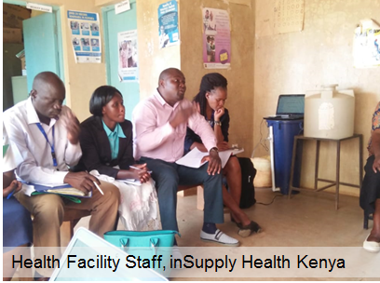
Across All Levels
Malawi and Rwanda - community health workers for child health products
Kenya - county, subcounty and community level for immunization and family planning
Pakistan and Guinea - district level for immunization supply chain
Myanmar and Indonesia - district level for family planning
Tanzania - national, regional, district and facility level
Ethiopia - national and regional hubs
Notes:
IMPACT teams can be implemented at every level of the health system. In central level board rooms, in health facilities, under a tree, by candlelight, with community health volunteers. Our experience has been that IMPACT Teams are in fact most effectual when operationalized at the subnational level (district/county) as they have a greater understanding of the root causes of supply chain performance challenges, because they are close to the problem and are more empowered with the authority to make changes.

Slide 53
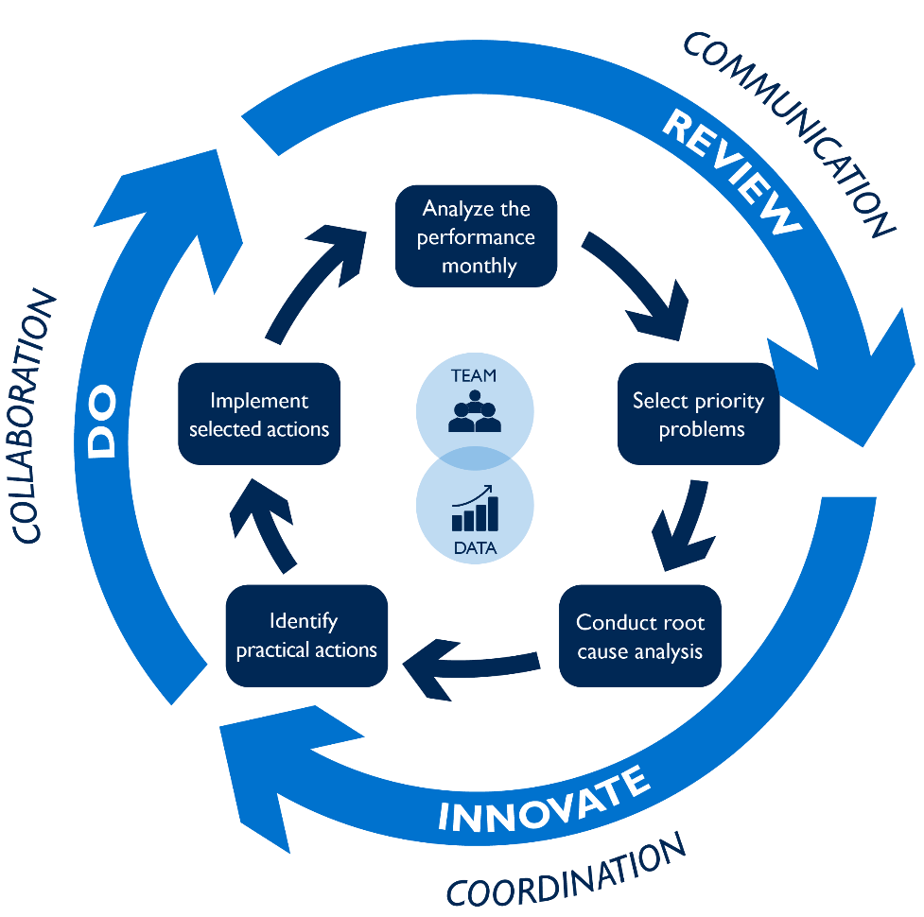
Common Features
IMPACT Teams meet routinely and follow a structured & rigorous process for problem-solving and action planning
Trained to develop, interpret and set targets for key supply chain indicators, and use action oriented dashboards
Encouraged to follow a structured, problem-solving process
Empowered to use their data for operational and strategic decisions with ultimate goal of improving the performance of their supply chain
A common goal, structured approach, standard team agenda and tools
Notes:
across disciplines and levels to train team members to develop, interpret, and set targets for key supply chain indicators; encourages a structured and rigorous problem solving process; and empowers members to use data for operational and strategic decisions.
IMPACT use a continuous cycle of Review-Innovate-Do. Reviewing the data, prioritizing problems, identifying root causes, then innovating on solutions, and finally doing something to address the problem by taking action. This cycle enables
IMPACT Teams are most effectual when operationalized at the subnational level (district/county) as they have a greater understanding of the root causes of supply chain performance challenges, because they are close to the problem and are more empowered with the authority to make changes.

Slide 54
Guiding Principles of IMPACT Teams
Build on Existing Mechanisms
Building on ongoing, routine meetings or structures at the county level, e.g. Commodity Security Technical Working Group meetings/structure, Health facility in-charges meetings, District EPI meetings
Access, enhance existing data
DHIS2, LMIS, FP Dashboard, Vaccine stock management tool
Data visualization and utilization for decision-making
Analyzing data from existing systems, identify relevant supply chain performance indicators, visualized for easy interpretation and effective decision making

Slide 55
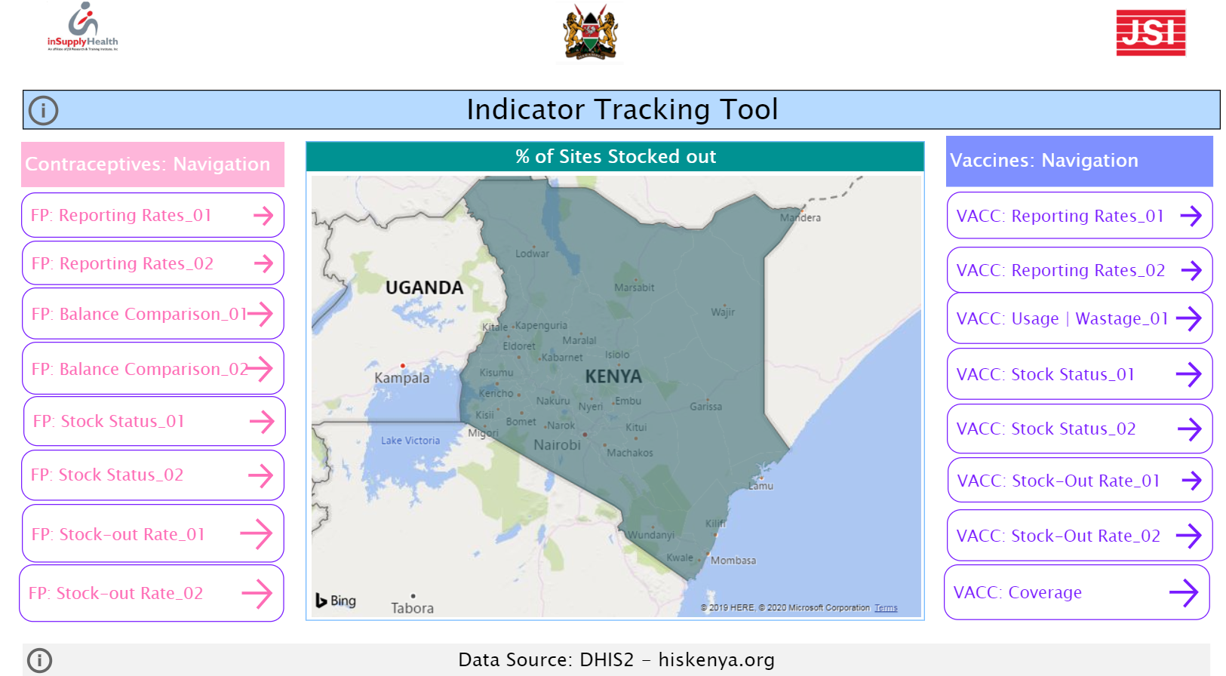
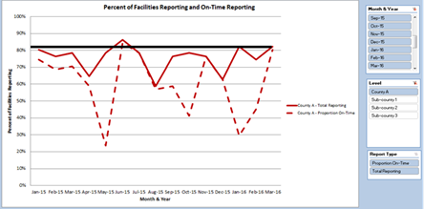
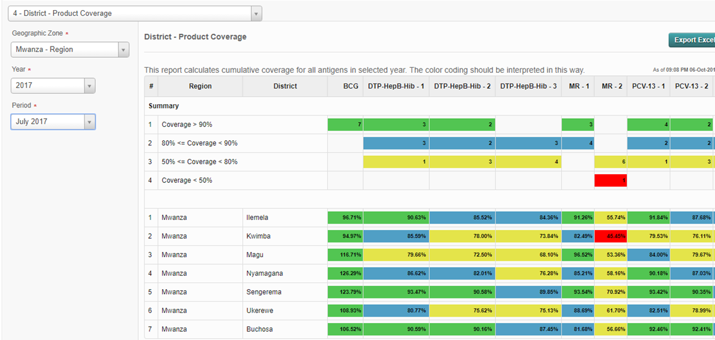
Dashboards

Slide 56
Dashboards
inSupply Health Kenya
INCREASED DATA ANALYTIC CAPACITY AND DATA USE
“Initially we would have raw data and try to make sense of it. But now with the IMPACT Team we came up with tools, the dashboards that now try to make it easier for us using color coding and graphs. At a glance you can be able to make decisions quite easily unlike in the past where we used to have a table, try to make sense out of it, trying to draw some conclusions.”
-Kenya
Notes:
Ethiopia IMPACT team members
Hub Manager/Deputy manager
Forecasting and Capacity Building Team Leader/Officer
Stock and Distribution Officer(s)/Coordinator(s)
Zonal/Regional Pharmacy Logistics Officer
Lab Officer (at hub)
Supply Chain Partners (3-4)
(Hub IT = resource person)
Vaccine SC officers
Warehouse Managers
M&E personel

Slide 57
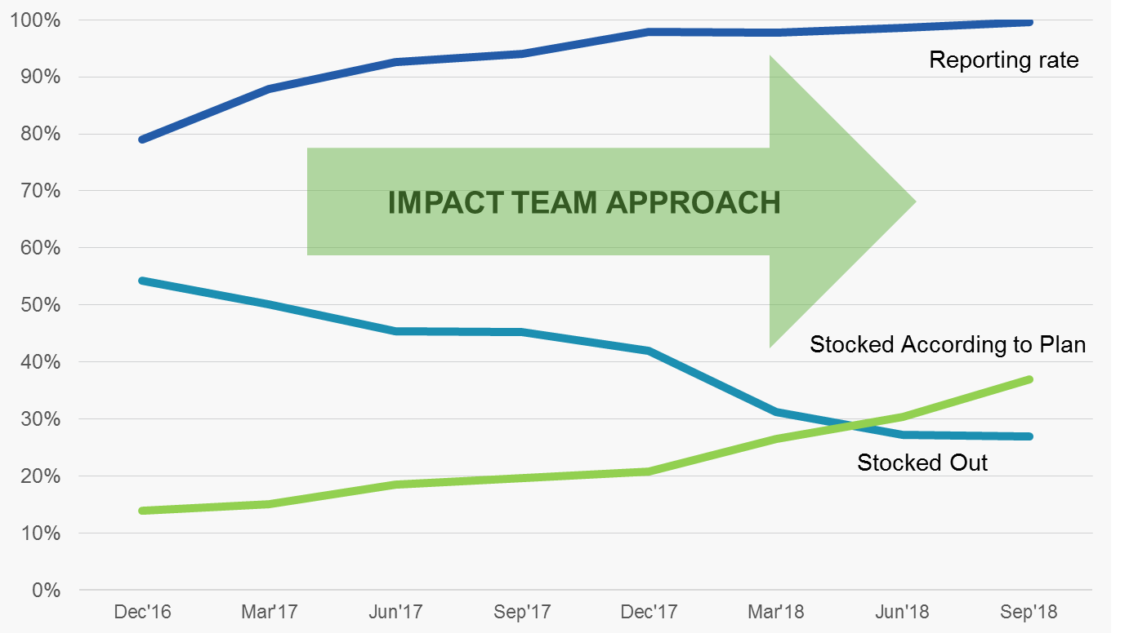
Results: Less Stock outs
Supply Chain Performance Southern Shan State, Myanmar

Slide 58
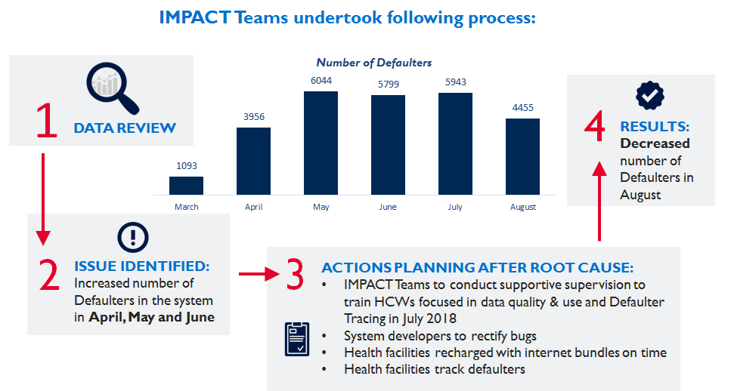
Results: Decreased Defaulters
In Dodoma Tanzania

Slide 59
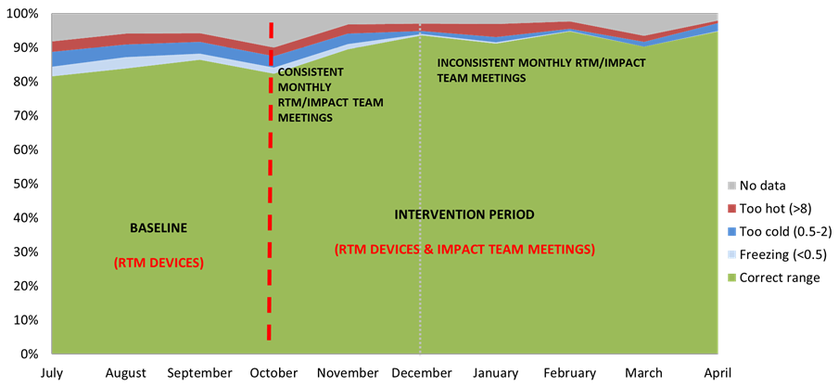
Results: Improved Cold Chain

Slide 60
Grass Roots Data Use
“Get data in front of people and they get excited. Create a competitive advantage, stimulate the demand for data from the grass roots!” -Ethiopia
“We become interested in trying to solve the problem. We are fired up to see the data there. That’s the result of our work!”
-Indonesia
JSI Ethiopia
Notes:
Democratization of data, Get data in front of people and they get excited, Create a competitive advantage, stimulate demand for data from the grass roots, Integration of people, technology and processes

Slide 61
Challenges
Competing priorities, frequent staff transfers, and limited human resources are common barriers to IMPACT Team success
“The changing bureaucracy [is a challenge]. Sometimes we haven’t even settled in and learned something, we’re already transferred to another place. We’re just starting to concentrate on one thing, we’re transferred. That is what sometimes creates problems in QIT activities. The old staff is transferred and we get new people again and again.” -Indonesia
“[The IMPACT Team] has slowed down its activities….The coordination of the meeting was mainly being done by JSI. They would remind us on when we would have the next meeting and what the agenda would be.” -Kenya
Partner support (financial and technical) still seen as necessary for IMPACT Team functioning

Slide 62
Key Lessons for IMPACT Teams
People need skills, capacity, and motivation for data analytics and visualization.
Processes must be in place to facilitate data-informed decision-making.
Data/Technology systems and decision support tools (dashboards) must support identification of root cause.
Leadership must be available and committed to motivate and support decision-making.
Financial and structural resources must be leveraged for IMPACT Team sustainability.
Notes:
Across our implementations we’ve learned a number of lessons]
There is sometimes a temptation to make fancy visualizations or to animate elements; what we’ve found that simple, actionable analytics is important. Checking-in with users to make sure that the visualizations meet their needs is key
We’ve seen a number of areas require additional capacity building for IMPACT teams
In Pakistan, we provided training on how to read simple graphs
In other contexts, we’ve provided training to really get at the root cause analysis

Slide 63
Thank you!

